Slide 1
COMP108
Algorithmic Foundations
Divide and Conquer
Prudence Wong
http://www.csc.liv.ac.uk/~pwong/teaching/comp108/201617

Slide 2
Pancake Sorting
Input: Stack of pancakes, each of different sizes
Output: Arrange in order of size (smallest on top)
Action: Slip a flipper under one of the pancakes and flip over the whole stack above the flipper
3
2
finish
4
1
1
start
2
3
4

Slide 3
Triomino Puzzle
Input: 2^{n}-by-2^{n} chessboard with one missing square &
many L-shaped tiles of 3 adjacent squares
Question: Cover the chessboard with L-shaped tiles without overlapping
2^{n}
Is it do-able?
2^{n}

Slide 4
Divide and Conquer …

Slide 5
Learning outcomes
Understand how divide and conquer works and able to analyse complexity of divide and conquer methods by solving recurrence
See examples of divide and conquer methods

Slide 6
Recursively finding the sum
12 34 2 9 7 5

Slide 7
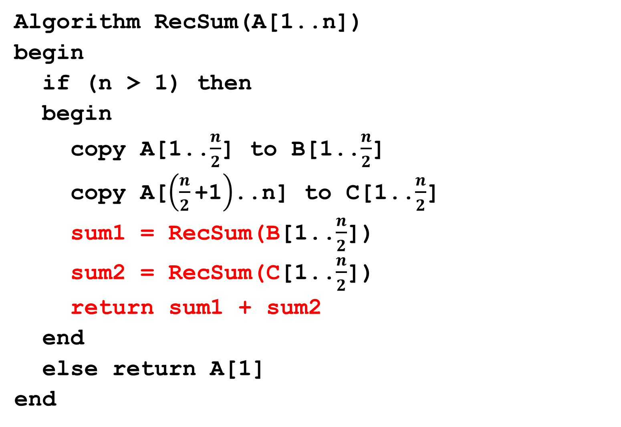
Assuming n is power of 2
Algorithm RecSum(A[1..n])
begin
if (n > 1) then
begin
copy A[1..$\frac{n}{2}$] to B[1..$\frac{n}{2}$]
copy A[$\left(\frac{n}{2}\text{+1}\right)$..n] to C[1..$\frac{n}{2}$]
sum1 = RecSum(B[1..$\frac{n}{2}$])
sum2 = RecSum(C[1..$\frac{n}{2}$])
return sum1 + sum2
end
else return A[1]
end

Slide 8
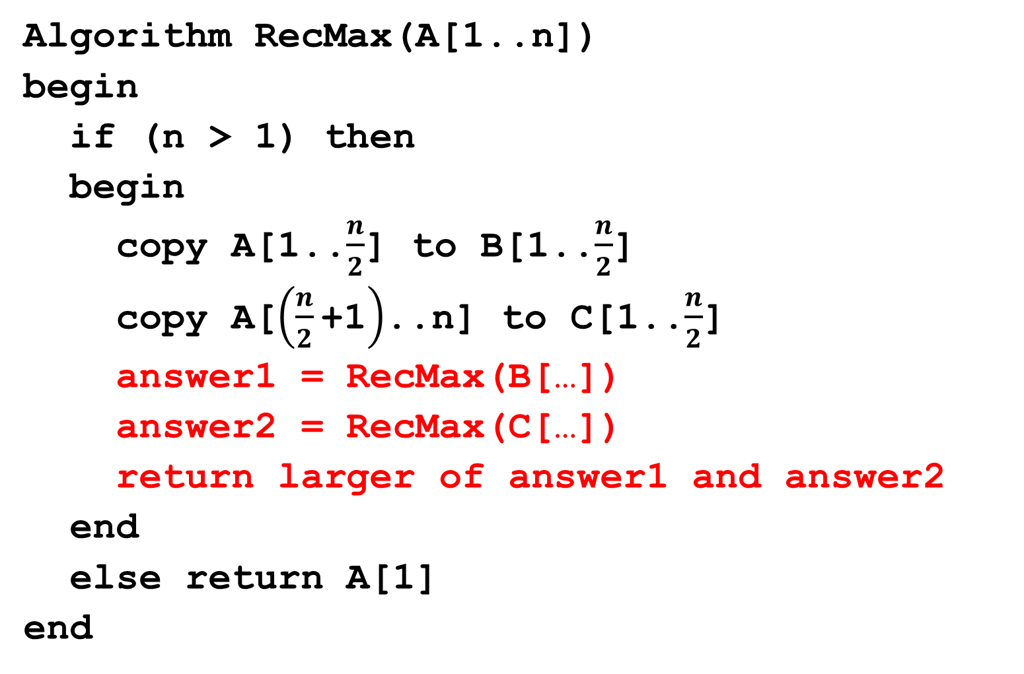
Finding maximum
Algorithm RecMax(A[1..n])
begin
if (n > 1) then
begin
copy A[1..$\frac{n}{2}$] to B[1..$\frac{n}{2}$]
copy A[$\left(\frac{n}{2}\text{+1}\right)$..n] to C[1..$\frac{n}{2}$]
answer1 = RecMax(B[…])
answer2 = RecMax(C[…])
return larger of answer1 and answer2
end
else return A[1]
end

Slide 9
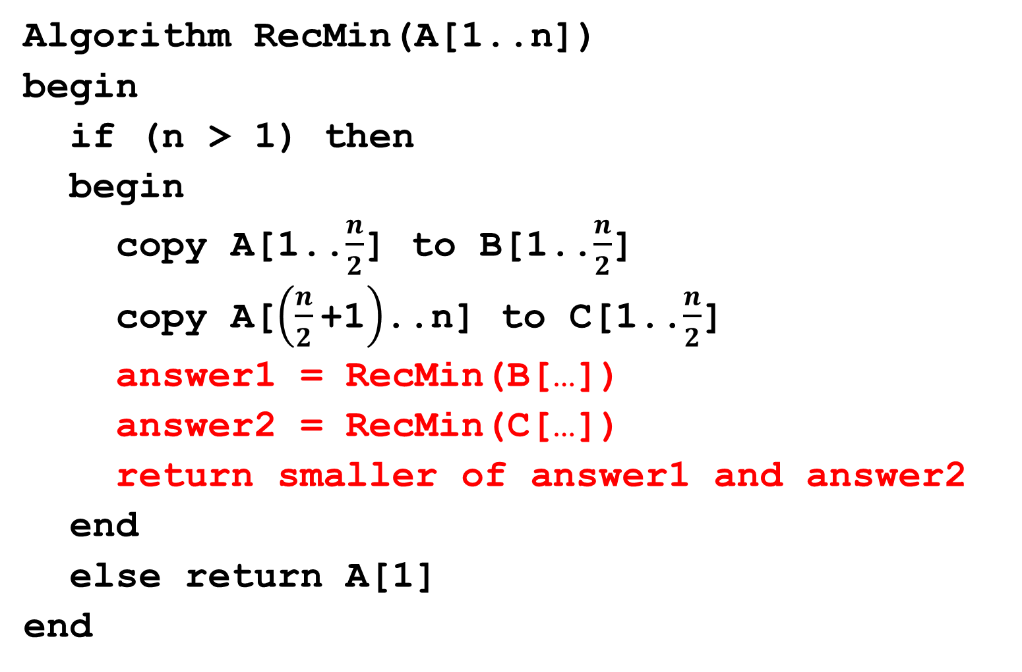
Finding minimum
Algorithm RecMin(A[1..n])
begin
if (n > 1) then
begin
copy A[1..$\frac{n}{2}$] to B[1..$\frac{n}{2}$]
copy A[$\left(\frac{n}{2}\text{+1}\right)$..n] to C[1..$\frac{n}{2}$]
answer1 = RecMin(B[…])
answer2 = RecMin(C[…])
return smaller of answer1 and answer2
end
else return A[1]
end

Slide 10
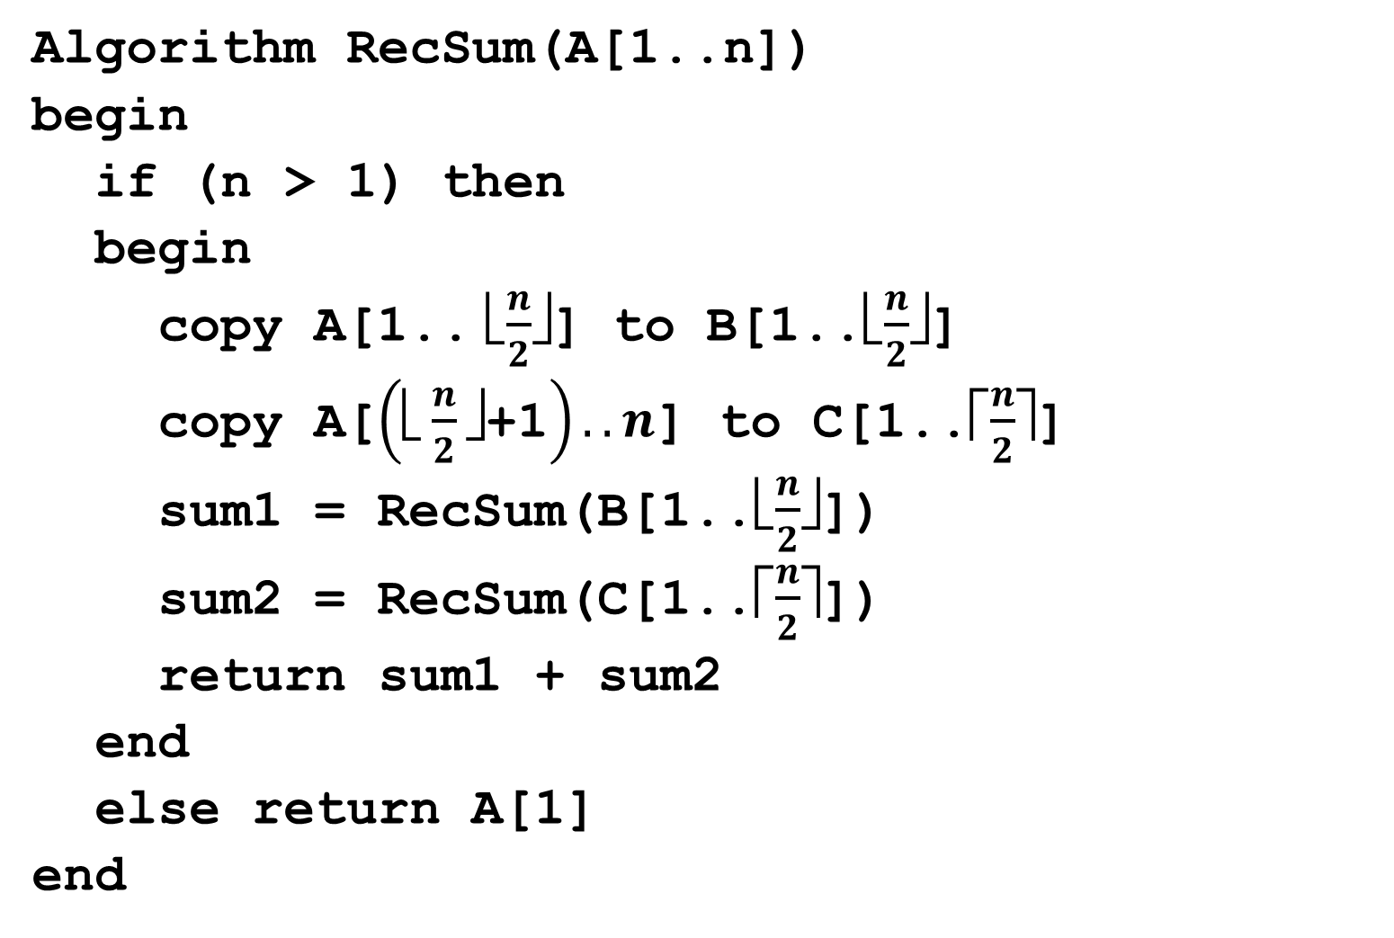
Arbitrary n
Algorithm RecSum(A[1..n])
begin
if (n > 1) then
begin
copy A[1.. ⎣$\frac{n}{2}$⎦] to B[1..⎣$\frac{n}{2}$⎦]
copy A[$\left(\text{}\frac{n}{2}\text{✗+1}\right)..n$] to C[1..⎡$\frac{n}{2}$⎤]
sum1 = RecSum(B[1..⎣$\frac{n}{2}$⎦])
sum2 = RecSum(C[1..⎡$\frac{n}{2}$⎤])
return sum1 + sum2
end
else return A[1]
end

Slide 11
Binary Search
Recall that we have learnt binary search:
Input: a sequence of n sorted numbers a₁, a₂, …, a_{n}; and a number X
Idea of algorithm:
  compare X with number in the middle
  then focus on only the first half or the second half (depend on whether X is smaller or greater than the middle number)
  reduce the amount of numbers to be searched by half

Slide 12
Binary Search (2)
we first work on n numbers, from a[1]..a[n]
3 7 11 12 15 19 24 33 41 55
24
19 24 33 41 55
24
19 24
24
then we work on n/2 numbers,
from a[n/2+1]..a[n]
further reduce by half

Slide 13
Recursive Binary Search
RecurBinarySearch(A, first, last, X)
begin
if (first > last) then
return false
mid = ⎣(first + last)/2⎦
if (X == A[mid]) then
return true
if (X < A[mid]) then
return RecurBinarySearch(A, first, mid-1, X)
else
return RecurBinarySearch(A, mid+1, last, X)
end

Slide 14
Recursive Binary Search
RecurBinarySearch(A, first, last, X)
begin
if (first > last) then
return false
mid = ⎣(first + last)/2⎦
if (X == A[mid]) then
return true
if (X < A[mid]) then
return RecurBinarySearch(A, first, mid-1, X)
else
return RecurBinarySearch(A, mid+1, last, X)
end
invoke by calling
RecurBinarySearch(A, 1, n, X)
return true if X is found,
false otherwise

Slide 15
Divide and Conquer
One of the best-known algorithm design techniques
Idea:
  A problem instance is divided into several smaller instances of the same problem, ideally of about same size
  The smaller instances are solved, typically recursively
  The solutions for the smaller instances are combined to get a solution to the large instance

Slide 16
Merge Sort …

Slide 17
Merge sort
using divide and conquer technique
divide the sequence of n numbers into two halves
recursively sort the two halves
merge the two sorted halves into a single sorted sequence

Slide 18
51, 13, 10, 64, 34, 5, 32, 21
we want to sort these 8 numbers,
divide them into two halves

Slide 19
51, 13, 10, 64, 34, 5, 32, 21
51, 13, 10, 64
34, 5, 32, 21
divide these 4 numbers into halves
similarly for these 4

Slide 20
51, 13, 10, 64, 34, 5, 32, 21
51, 13, 10, 64
34, 5, 32, 21
51, 13
10, 64
34, 5
32, 21
further divide each shorter sequence …
until we get sequence with only 1 number

Slide 21
51, 13, 10, 64, 34, 5, 32, 21
51, 13, 10, 64
34, 5, 32, 21
51, 13
10, 64
34, 5
32, 21
51
13
10
64
34
5
32
21
merge pairs of single number into a sequence of 2 sorted numbers

Slide 22
51, 13, 10, 64, 34, 5, 32, 21
51, 13, 10, 64
34, 5, 32, 21
51, 13
10, 64
34, 5
32, 21
51
13
10
64
34
5
32
21
13, 51
10, 64
5, 34
21, 32
then merge again into sequences of 4 sorted numbers

Slide 23
51, 13, 10, 64, 34, 5, 32, 21
51, 13, 10, 64
34, 5, 32, 21
51, 13
10, 64
34, 5
32, 21
51
13
10
64
34
5
32
21
13, 51
10, 64
5, 34
21, 32
10, 13, 51, 64
5, 21, 32, 34
one more merge give the final sorted sequence

Slide 24
51, 13, 10, 64, 34, 5, 32, 21
51, 13, 10, 64
34, 5, 32, 21
51, 13
10, 64
34, 5
32, 21
51
13
10
64
34
5
32
21
13, 51
10, 64
5, 34
21, 32
10, 13, 51, 64
5, 21, 32, 34
5, 10, 13, 21, 32, 34, 51, 64

Slide 25
Summary
Divide
  dividing a sequence of n numbers into two smaller sequences is straightforward
Conquer
  merging two sorted sequences of total length n can also be done easily, at most n-1 comparisons

Slide 26
10, 13, 51, 64
5, 21, 32, 34
Result:
To merge two sorted sequences,
we keep two pointers, one to each sequence
Compare the two numbers pointed,
copy the smaller one to the result
and advance the corresponding pointer

Slide 27
10, 13, 51, 64
5, 21, 32, 34
Result:
5,
Then compare again the two numbers
pointed to by the pointer;
copy the smaller one to the result
and advance that pointer

Slide 28
10, 13, 51, 64
5, 21, 32, 34
Result:
5, 10,
Repeat the same process …

Slide 29
10, 13, 51, 64
5, 21, 32, 34
Result:
5, 10, 13
Again …

Slide 30
10, 13, 51, 64
5, 21, 32, 34
Result:
5, 10, 13, 21
and again …

Slide 31
10, 13, 51, 64
5, 21, 32, 34
Result:
5, 10, 13, 21, 32
…

Slide 32
10, 13, 51, 64
5, 21, 32, 34
Result:
5, 10, 13, 21, 32, 34
When we reach the end of one sequence,
simply copy the remaining numbers in the other sequence to the result

Slide 33
10, 13, 51, 64
5, 21, 32, 34
Result:
5, 10, 13, 21, 32, 34, 51, 64
Then we obtain the final sorted sequence

Slide 34
Pseudo code
Algorithm Mergesort(A[1..n])
if n > 1 then begin
copy A[1..⎣n/2⎦] to B[1..⎣n/2⎦]
copy A[⎣n/2⎦+1..n] to C[1..⎡n/2⎤]
Mergesort(B[1..⎣n/2⎦])
Mergesort(C[1..⎡n/2⎤])
Merge(B, C, A)
end

Slide 35
MS(
51, 13, 10, 64, 34, 5, 32, 21
)
MS(
51, 13, 10, 64
)
MS(
34, 5, 32, 21
)
MS(
51, 13
)
MS(
10, 64
)
MS(
34, 5
)
MS(
32, 21
)
MS(
51
13
10
64
MS(
34
5
32
21
)
MS(
MS(
MS(
MS(
)
MS(
MS(
)
)
)
)
)
)
M(
13, 51
,
10, 64
)
M(
5, 34
,
21, 32
)
M(
10, 13, 51, 64
,
5, 21, 32, 34
)
5, 10, 13, 21, 32, 34, 51, 64

Slide 36
MS(
51, 13, 10, 64, 34, 5, 32, 21
)
1
11
MS(
51, 13, 10, 64
)
MS(
34, 5, 32, 21
)
2
6
16
12
MS(
51, 13
)
MS(
10, 64
)
MS(
34, 5
)
MS(
32, 21
)
3
4
7
8
13
14
17
18
MS(
51
13
10
64
MS(
34
5
32
21
)
MS(
MS(
MS(
MS(
)
MS(
MS(
)
)
)
)
)
)
5
9
15
19
M(
13, 51
,
10, 64
)
M(
5, 34
,
21, 32
)
10
20
M(
10, 13, 51, 64
,
5, 21, 32, 34
)
21
5, 10, 13, 21, 32, 34, 51, 64
order of execution

Slide 37
Pseudo code
Algorithm Merge(B[1..p], C[1..q], A[1..p+q])
set i=1, j=1, k=1
while i<=p and j<=q do
begin
if B[i]≤C[j] then
set A[k] = B[i] and i = i+1
else set A[k] = C[j] and j = j+1
k = k+1
end
if i==p+1 then copy C[j..q] to A[k..(p+q)]
else copy B[i..p] to A[k..(p+q)]

Slide 38
p=4
q=4
B:
10, 13, 51, 64
C:
5, 21, 32, 34
 | i | j | k | A[ ]
Before loop | 1 | 1 | 1 | empty
End of 1st iteration | 1 | 2 | 2 | 5
End of 2nd iteration | 2 | 2 | 3 | 5, 10
End of 3rd | 3 | 2 | 4 | 5, 10, 13
End of 4th | 3 | 3 | 5 | 5, 10, 13, 21
End of 5th | 3 | 4 | 6 | 5, 10, 13, 21, 32
End of 6th | 3 | 5 | 7 | 5, 10, 13, 21, 32, 34
 |  |  |  | 5, 10, 13, 21, 32, 34, 51, 64

Slide 39
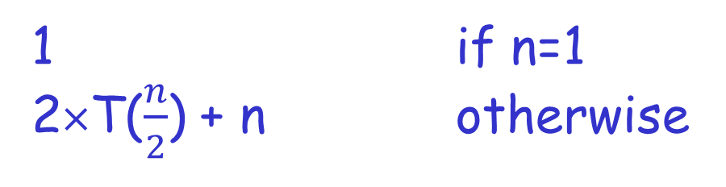
Time complexity
Let T(n) denote the time complexity of running merge sort on n numbers.
1 if n=1
2×T($\frac{n}{2}$) + n otherwise
T(n) =
We call this formula a recurrence.
A recurrence is an equation or inequality that describes a function in terms of its value on smaller inputs.
To solve a recurrence is to derive asymptotic bounds on the solution

Slide 40

Time complexity
1 if n=1
2×T($\frac{n}{2}$) + n otherwise
Prove that is O(n log n)
Make a guess: T(n) ≤ 2 n log n (We prove by MI)
T(n) =
For the base case when n=2,
L.H.S = T(2) = 2×T(1) + 2 = 4,
R.H.S = 2 × 2 log 2 = 4
L.H.S ≤ R.H.S
Substitution method

Slide 41
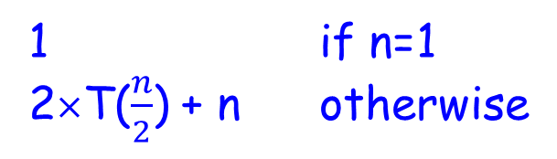

Time complexity
1 if n=1
2×T($\frac{n}{2}$) + n otherwise
Prove that is O(n log n)
Make a guess: T(n) ≤ 2 n log n (We prove by MI)
Assume true for all n'<n [assume T($\frac{n}{2}$) ≤ 2 x ($\frac{n}{2}$) x log($\frac{n}{2}$)]
T(n) = 2×T($\frac{n}{2}$)+n
T(n) =

Slide 43
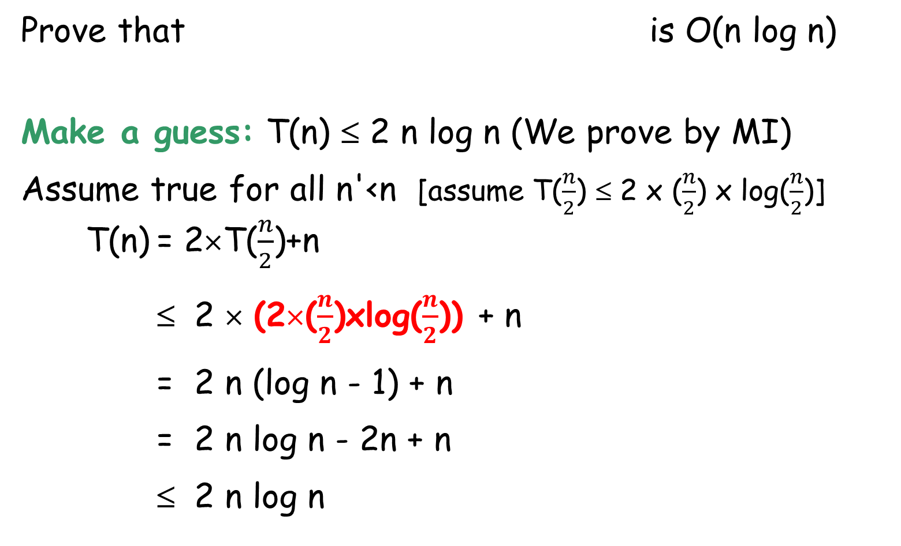
Time complexity
1 if n=1
2×T($\frac{n}{2}$) + n otherwise
Prove that is O(n log n)
Make a guess: T(n) ≤ 2 n log n (We prove by MI)
Assume true for all n'<n [assume T($\frac{n}{2}$) ≤ 2 x ($\frac{n}{2}$) x log($\frac{n}{2}$)]
T(n) = 2×T($\frac{n}{2}$)+n
≤ 2 × (2×($\frac{n}{2}$)xlog($\frac{n}{2}$)) + n
= 2 n (log n - 1) + n
= 2 n log n - 2n + n
≤ 2 n log n
T(n) =
by hypothesis
i.e., T(n) ≤ 2 n log n

Slide 44

Example
1 if n=1
T($\frac{n}{2}$) + 1 otherwise
T(n) =
Guess: T(n) ≤ 2 log n
For the base case when n=2,
L.H.S = T(2) = T(1) + 1 = 2
R.H.S = 2 log 2 = 2
L.H.S ≤ R.H.S

Slide 45
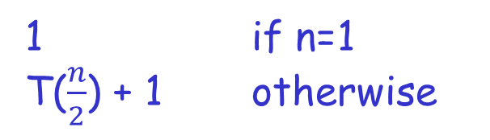
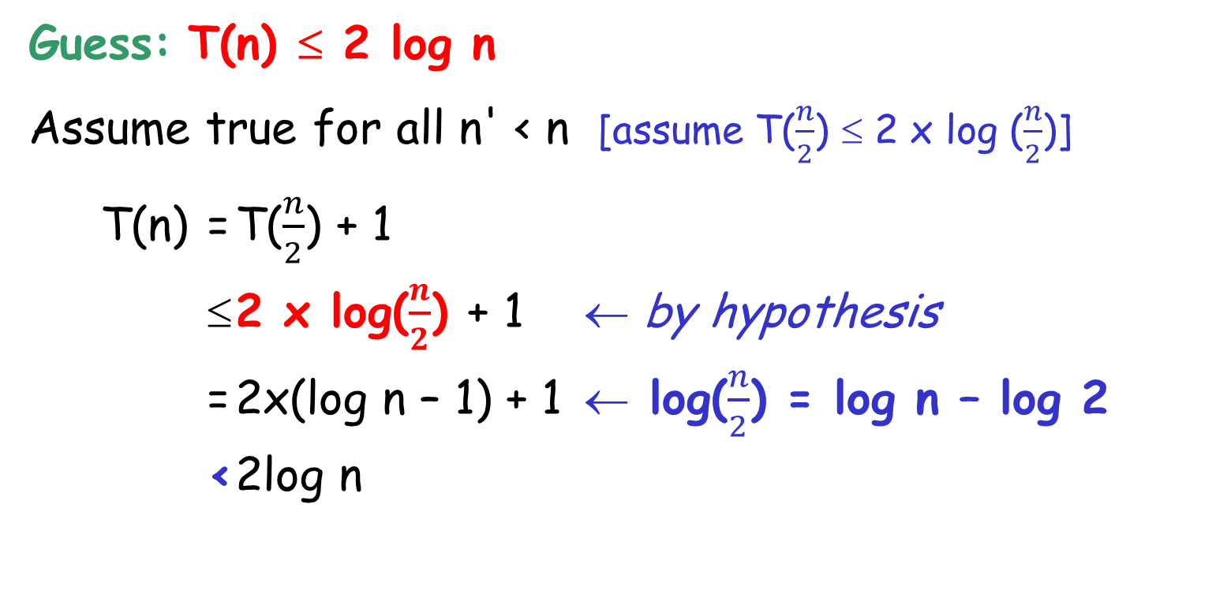
Example
1 if n=1
T($\frac{n}{2}$) + 1 otherwise
T(n) =
Guess: T(n) ≤ 2 log n
Assume true for all n' < n [assume T($\frac{n}{2}$) ≤ 2 x log ($\frac{n}{2}$)]
T(n) = T($\frac{n}{2}$) + 1
≤ 2 x log($\frac{n}{2}$) + 1 ← by hypothesis
= 2x(log n – 1) + 1 ← log($\frac{n}{2}$) = log n – log 2
< 2log n
i.e., T(n) ≤ 2 log n

Slide 46

More example
1 if n=1
2 x T($\frac{n}{2}$) + 1 otherwise
Prove that is O(n)
Guess: T(n) ≤ 2n – 1
T(n) =
For the base case when n=1,
L.H.S = T(1) = 1
R.H.S = 2×1 - 1 = 1
L.H.S ≤ R.H.S

Slide 47
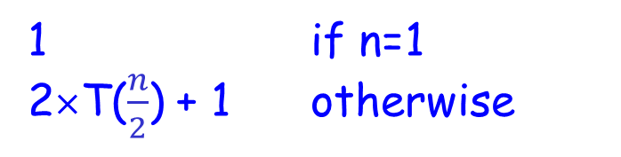
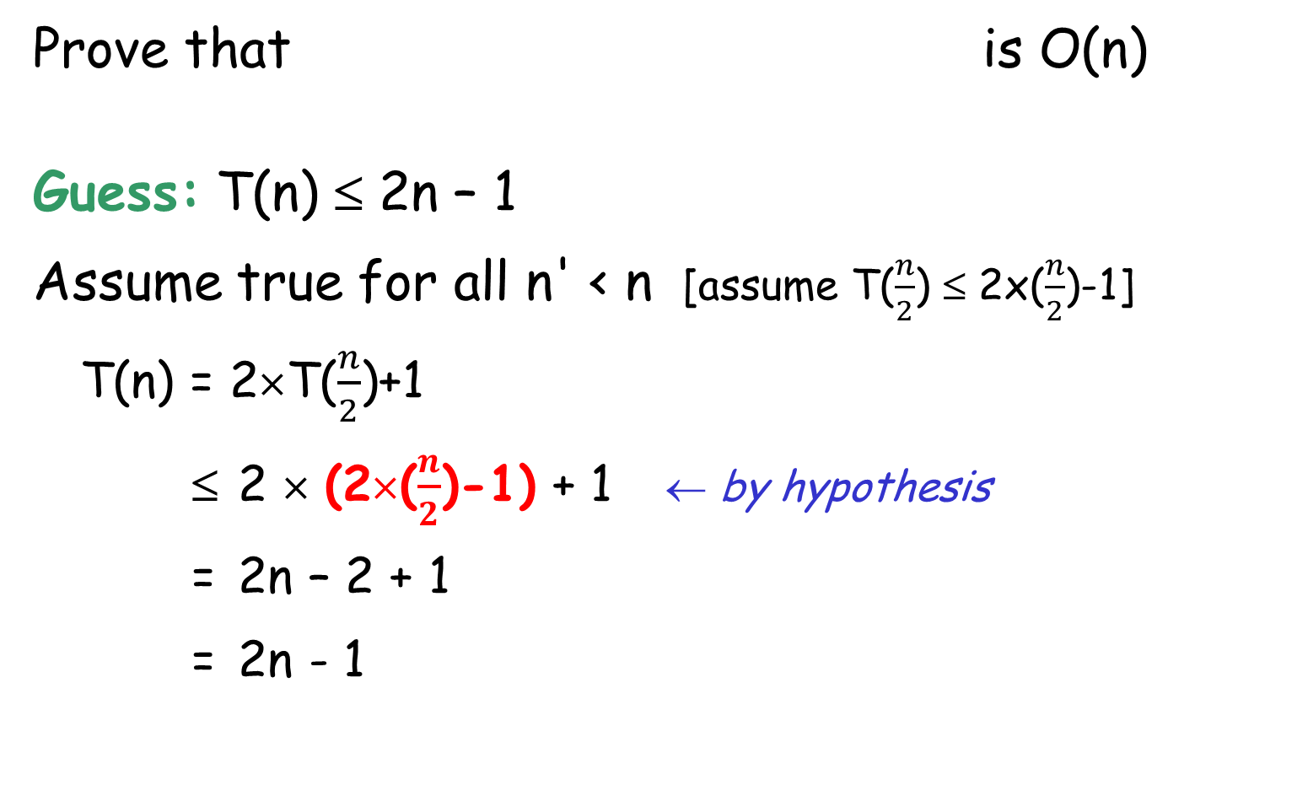
More example
1 if n=1
2×T($\frac{n}{2}$) + 1 otherwise
Prove that is O(n)
Guess: T(n) ≤ 2n – 1
Assume true for all n' < n [assume T($\frac{n}{2}$) ≤ 2x($\frac{n}{2}$)-1]
T(n) = 2×T($\frac{n}{2}$)+1
≤ 2 × (2×($\frac{n}{2}$)-1) + 1 ← by hypothesis
= 2n – 2 + 1
= 2n - 1
T(n) =
i.e., T(n) ≤ 2n-1

Slide 48
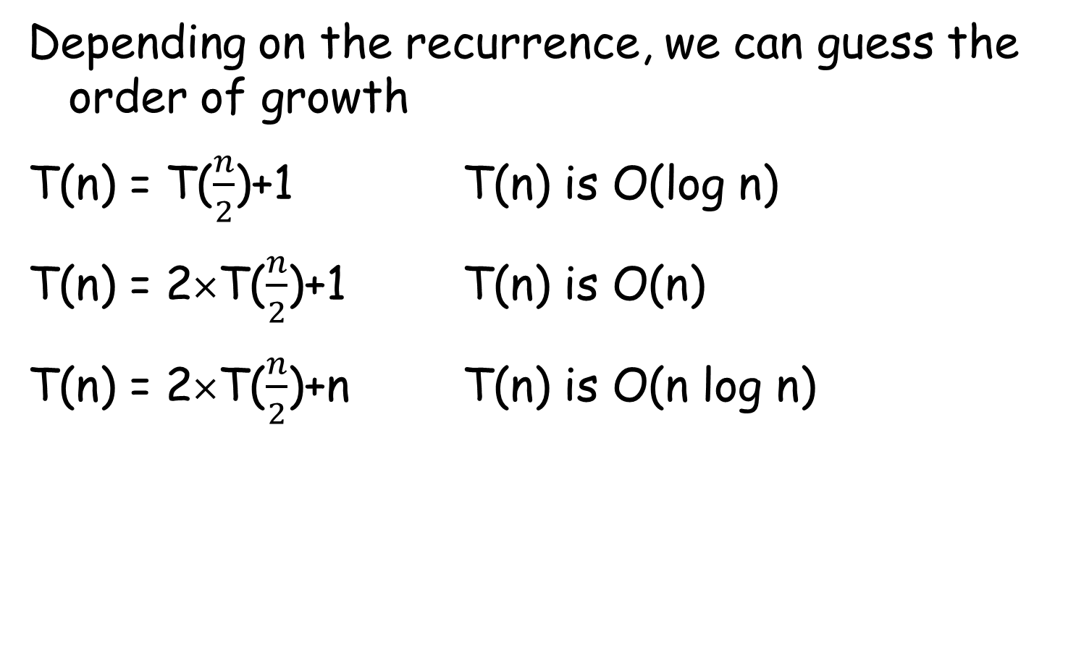
Summary
Depending on the recurrence, we can guess the order of growth
T(n) = T($\frac{n}{2}$)+1 T(n) is O(log n)
T(n) = 2×T($\frac{n}{2}$)+1 T(n) is O(n)
T(n) = 2×T($\frac{n}{2}$)+n T(n) is O(n log n)

Slide 49
Intuitive Idea of time complexity
51, 13, 10, 64, 34, 5, 32, 21
51, 13, 10, 64
34, 5, 32, 21
51, 13
10, 64
34, 5
32, 21
51
13
10
64
34
5
32
21
How many levels?
How many nodes? (rectangles)
How much time is needed for each level/node?

Slide 50
Intuitive Idea of time complexity
51, 13, 10, 64, 34, 5, 32, 21
51, 13, 10, 64
10, 64
10
How many levels?
How many nodes? (rectangles)
How much time is needed for each level/node?

Slide 51
Tower of Hanoi …

Slide 52
Tower of Hanoi - Initial config
There are three pegs and some discs of different sizes are on Peg A
1
2
3
A
B
C

Slide 53
Tower of Hanoi - Final config
Want to move the discs to Peg C
1
2
3
A
B
C

Slide 54
Tower of Hanoi - Rules
Only 1 disk can be moved at a time
A disc cannot be placed on top of other discs that are smaller than it
3
2
Target: Use the smallest number of moves

Slide 55
Tower of Hanoi - One disc only
Easy!
1
A
B
C

Slide 56
Tower of Hanoi - One disc only
Easy! Need one move only.
1
A
B
C

Slide 57
Tower of Hanoi - Two discs
We first need to move Disc-2 to C, How?
by moving Disc-1 to B first, then Disc-2 to C
1
2
A
B
C

Slide 58
Tower of Hanoi - Two discs
Next?
Move Disc-1 to C
1
2
A
B
C

Slide 59
Tower of Hanoi - Two discs
Done!
1
2
A
B
C

Slide 60
Tower of Hanoi - Three discs
We first need to move Disc-3 to C, How?
  Move Disc-1&2 to B (recursively)
1
2
3
A
B
C

Slide 61
Tower of Hanoi - Three discs
  Then move Disc-3 to C
We first need to move Disc-3 to C, How?
  Move Disc-1&2 to B (recursively)
3
2
1
A
B
C

Slide 62
Tower of Hanoi - Three discs
Only task left: move Disc-1&2 to C (similarly as before)
1
2
3
A
B
C

Slide 63
Tower of Hanoi - Three discs
Only task left: move Disc-1&2 to C (similarly as before)
1
2
3
A
B
C

Slide 64
Tower of Hanoi - Three discs
Done!
1
2
3
A
B
C

Slide 65
Tower of Hanoi
invoke by calling
ToH(3, A, C, B)
ToH(num_disc, source, dest, spare)
begin
if (num_disc > 1) then
ToH(num_disc-1, source, spare, dest)
Move the disc from source to dest
if (num_disc > 1) then
ToH(num_disc-1, spare, dest, source)
end

Slide 66
ToH(3, A, C, B)
ToH(2, A, B, C)
move 1 disc
from A to C
ToH(2, B, C, A)
ToH(1, A, C, B)
ToH(1, C, B, A)
ToH(1, B, A, C)
ToH(1, A, C, B)
move 1 disc
from A to B
move 1 disc
from B to C
move 1 disc
from A to C
move 1 disc
from C to B
move 1 disc
from B to A
move 1 disc
from A to C

Slide 67
ToH(3, A, C, B)
1
8
7
ToH(2, A, B, C)
move 1 disc
from A to C
ToH(2, B, C, A)
2
5
9
12
4
11
ToH(1, A, C, B)
ToH(1, C, B, A)
ToH(1, B, A, C)
ToH(1, A, C, B)
move 1 disc
from A to B
move 1 disc
from B to C
3
6
10
13
move 1 disc
from A to C
move 1 disc
from C to B
move 1 disc
from B to A
move 1 disc
from A to C
from A to C; from A to B; from C to B;
from A to C;
from B to A; from B to C; from A to C;

Slide 68
Time complexity
Let T(n) denote the time complexity of running the Tower of Hanoi algorithm on n discs.
T(n) = T(n-1) + 1 + T(n-1)
move n-1 discs from A to B
move n-1 discs from B to C
move Disc-n from A to C
1 if n=1
2×T(n-1) + 1 otherwise
T(n) =

Slide 69
Time complexity (2)
T(n) = 2×T(n-1) + 1
= 2[2×T(n-2) + 1] + 1
= 2² T(n-2) + 2 + 1
= 2² [2×T(n-3) + 1] + 2¹ + 2⁰
= 2³ T(n-3) + 2² + 2¹ + 2⁰
…
= 2^{k} T(n-k) + 2^{k-1} + 2^{k-2} + … + 2² + 2¹ + 2⁰
…
= 2^{n-1} T(1) + 2^{n-2} + 2^{n-3} + … + 2² + 2¹ + 2⁰
= 2^{n-1} + 2^{n-2} + 2^{n-3} + … + 2² + 2¹ + 2⁰
= 2^{n}-1
1 if n=1
2×T(n-1) + 1 otherwise
T(n) =

Slide 70
Time complexity (2)
T(n) = 2×T(n-1) + 1
= 2[2×T(n-2) + 1] + 1
= 2² T(n-2) + 2 + 1
= 2² [2×T(n-3) + 1] + 2¹ + 2⁰
= 2³ T(n-3) + 2² + 2¹ + 2⁰
…
= 2^{k} T(n-k) + 2^{k-1} + 2^{k-2} + … + 2² + 2¹ + 2⁰
…
= 2^{n-1} T(1) + 2^{n-2} + 2^{n-3} + … + 2² + 2¹ + 2⁰
= 2^{n-1} + 2^{n-2} + 2^{n-3} + … + 2² + 2¹ + 2⁰
= 2^{n}-1
1 if n=1
2×T(n-1) + 1 otherwise
T(n) =
iterative method
i.e., T(n) is O(2^{n})
In Tutorial 2, we prove by MI that
2⁰ + 2¹ + … + 2^{n-1} = 2^{n}-1

Slide 71
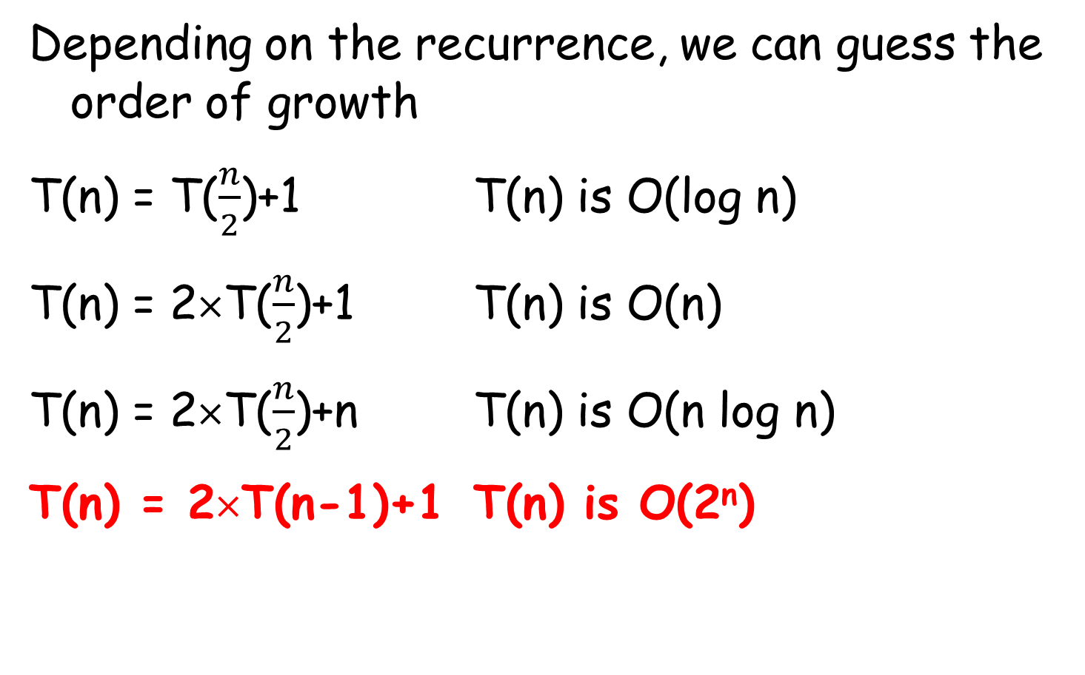
Summary - continued
Depending on the recurrence, we can guess the order of growth
T(n) = T($\frac{n}{2}$)+1 T(n) is O(log n)
T(n) = 2×T($\frac{n}{2}$)+1 T(n) is O(n)
T(n) = 2×T($\frac{n}{2}$)+n T(n) is O(n log n)
T(n) = 2×T(n-1)+1 T(n) is O(2^{n})

Slide 72
Fibonacci number …

Slide 73

Fibonacci's Rabbits
A pair of rabbits, one month old, is too young to reproduce. Suppose that in their second month, and every month thereafter, they produce a new pair.
end of
month-0
end of
month-1
end of
month-2
end of
month-3
How many
at end of
month-5, 6,7
and so on?
end of
month-4

Slide 74








Petals on flowers
1 petal:
white calla lily
2 petals:
euphorbia
3 petals:
trillium
5 petals:
columbine
8 petals:
bloodroot
13 petals:
black-eyed susan
21 petals:
shasta daisy
34 petals:
field daisy
Search: Fibonacci Numbers in Nature

Slide 75
Fibonacci number
Fibonacci number F(n)
1 if n = 0 or 1
F(n-1) + F(n-2) if n > 1
F(n) =
n | 0 | 1 | 2 | 3 | 4 | 5 | 6 | 7 | 8 | 9 | 10
F(n) | 1 | 1 | 2 | 3 | 5 | 8 | 13 | 21 | 34 | 55 | 89
Pseudo code for the recursive algorithm:
Algorithm F(n)
if n==0 or n==1 then
return 1
else
return F(n-1) + F(n-2)

Slide 76
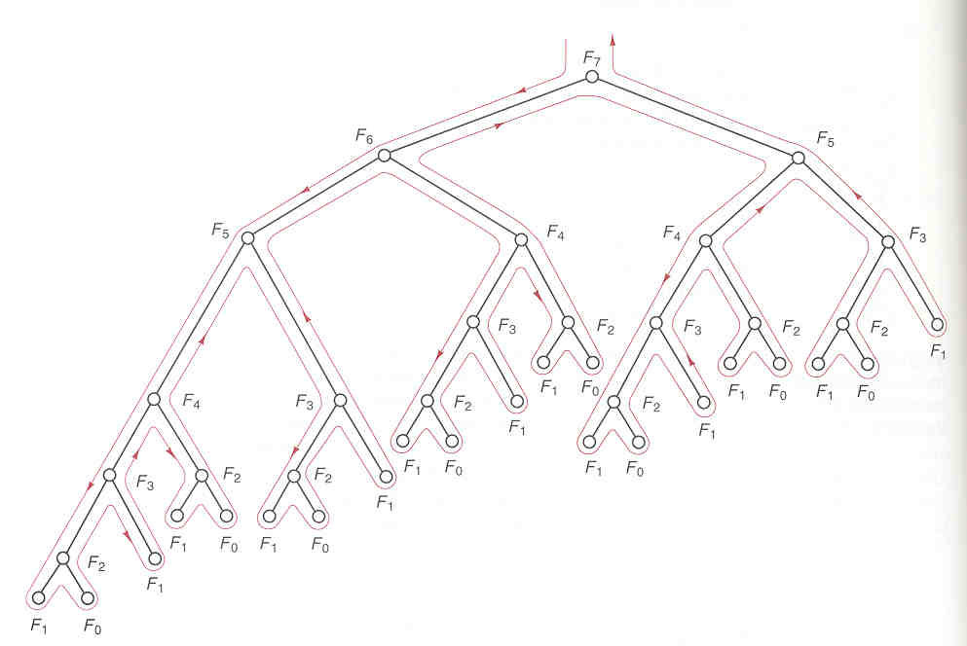
The execution of F(7)
F₇
F₆
F₅
F₅
F₄
F₄
F₃
F₃
F₂
F₃
F₂
F₂
F₁
F₄
F₃
F₂
F₁
F₀
F₂
F₁
F₀
F₁
F₀
F₁
F₁
F₃
F₂
F₂
F₁
F₀
F₁
F₀
F₁
F₁
F₀
F₁
F₀
F₂
F₁
F₁
F₀

Slide 77
The execution of F(7)
1
F₇
2
27
F₆
F₅
18
3
F₅
F₄
F₄
F₃
13
F₃
F₂
F₃
F₂
F₂
4
F₁
F₄
F₃
F₂
F₁
F₀
F₂
F₁
F₀
F₁
F₀
10
F₁
F₁
5
F₃
F₂
F₂
F₁
F₀
F₁
F₀
6
F₁
F₁
F₀
F₁
F₀
F₂
F₁
7
F₁
F₀
9
8
order of execution
(not everything shown)

Slide 78
The execution of F(7)
21
F₇
8
13
8
F₆
F₅
5
F₅
F₄
F₄
F₃
5
3
F₃
F₂
F₃
F₂
F₂
F₁
F₄
F₃
F₂
F₁
F₀
F₂
F₁
F₀
F₁
F₀
3
2
F₁
F₁
F₃
F₂
F₂
F₁
F₀
F₁
F₀
2
1
F₁
F₁
F₀
F₁
F₀
1
F₂
1
F₁
F₁
F₀
return value
(not everything shown)

Slide 79
Time complexity - exponential
f(n) = f(n-1) + f(n-2) + 1
= [f(n-2)+f(n-3)+1] + f(n-2) + 1
> 2 f(n-2)
> 2 [2×f(n-2-2)] = 2² f(n-4)
> 2² [2×f(n-4-2)] = 2³ f(n-6)
> 2³ [2×f(n-6-2)] = 2⁴ f(n-8)
…
> 2^{k} f(n-2k)
Suppose f(n) denote the time complexity to compute F(n)
exponential in n
If n is even, f(n) > 2^{n/2} f(0) = 2^{n/2}
If n is odd, f(n) > f(n-1) > 2^{(n-1)/2}

Slide 80
Challenges …

Slide 81

Challenge on substitution method
1 if n=1
4 x T($\frac{n}{4}$) + n otherwise
Prove that is O(n log n)
Guess: T(n) ≤ n log n
Base case: When n = 4,
Induction hypothesis: Assume the property holds for all n’ < n, i.e., assume that
T(n/4) ≤ ???
Induction step: For n, …
T(n) =

Slide 82
Challenge on iterative method
T(n) = 2T(n-1) + 4
= 2[2xT(n-2) + 4] + 4
= 2² T(n-2) + 2x4 + 4
= 2² [2xT(n-3) + 4] + 2¹x4 + 2⁰x4
= 2³ T(n-3) + 2²x4 + 2¹x4 + 2⁰x4
…
= 2^{k} T(n-k) + 2^{k-1}x4 + … + 2²x4 + 2¹x4 + 2⁰x4
…
= 2^{n-1} T(1) + 2^{n-2}x4 + … + 2²x4 + 2¹x4 + 2⁰x4
= 2^{n-1}x4 + 2^{n-2}x4 + … + 2²x4 + 2¹x4 + 2⁰x4
= 4x(2^{n}-1)
4 if n=1
2×T(n-1) + 4 if n > 1
T(n) =
Use: 2⁰ + 2¹ + … + 2^{n-1} = 2^{n}-1

Slide 83
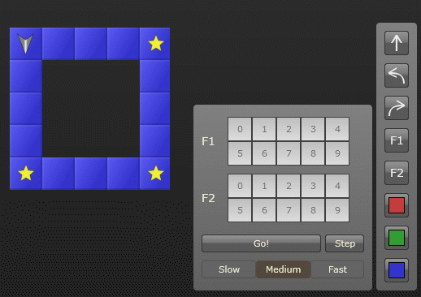
Robozzle - Recursion
Task: to program a robot to pick up all stars in a certain area
Command: Go straight, Turn Left, Turn Right

