Slide 1
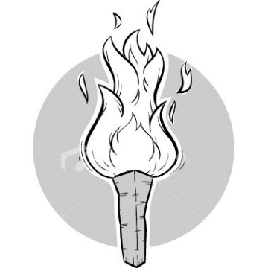
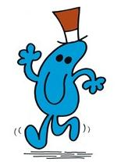
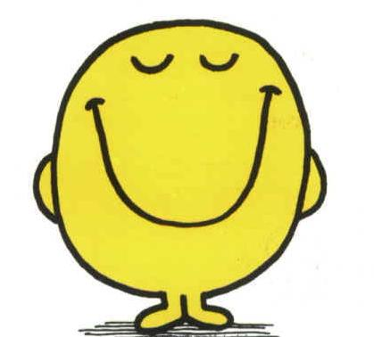
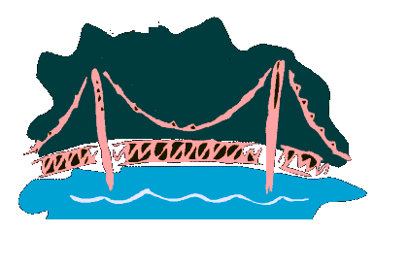
Crossing Bridge @ Night
1 min
each time, 2 persons share a torch
they walk @ speed of slower person
2 min
Target: all cross the bridge
5 min
10 min
Notes:
Mr Tall 1 min; Mr Busy 2 min; Mr Happy 5 min; Mr Slow 10 min;

Slide 2
Crossing Bridge @ Night
1 min
2 min
10 min
10 min
5 min

Slide 3
Crossing Bridge @ Night
1 min
2 min
10 min
1 min
10 min
5 min

Slide 4
Crossing Bridge @ Night
1 min
2 min
1 min
10 min
2 min
5 min
10 min

Slide 5
Crossing Bridge @ Night
1 min
2 min
10 min
1 min
5 min
2 min
10 min
1 min

Slide 6
Crossing Bridge @ Night
1 min
5 min
10 min
1 min
5 min
2 min
10 min
1 min
2 min

Slide 7
Crossing Bridge @ Night
Total: 19 min
1 min
5 min
How to do this quicker?
10 min
5 min
2 min
10 min
1 min
1 min
2 min

Slide 8
Quickest Way
1 min
2 min
2 min
5 min
10 min

Slide 9
Quickest Way
1 min
1 min
2 min
2 min
5 min
10 min

Slide 10
Quickest Way
1 min
5 min
10 min
1 min
10 min
2 min
2 min

Slide 11
Quickest Way
1 min
10 min
5 min
2 min
2 min
10 min
2 min
1 min

Slide 12
Quickest Way
1 min
2 min
5 min
2 min
2 min
10 min
2 min
1 min
10 min

Slide 13
Quickest Way
Total: 17 min only!
1 min
2 min
5 min
2 min
10 min
2 min
2 min
1 min
10 min

