Slide 1
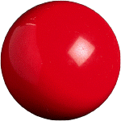
Which Ball is Heavier?
balance scale
9 balls look identically the same
but 1 is heavier than the rest
How to find the heavier one by weighing 2 times only?

Slide 2
Hint
balance scale
Weigh once if there are only 3 balls?

Slide 3
3 Balls
balance scale
A
B
C
3 Cases:
A heavier than B
B heavier than A
same weight
C is heavier

Slide 4
9 Balls
balance scale
A
B
C
3 Cases:
Group A heavier than group B
Repeat previous step with group A
Group B heavier than group A
Repeat with group B
same weight
Repeat with group C
3 a group

Slide 5
Generalisation
balance scale
27 balls
More balls?
27 balls?
81 balls?
In general?

