Slide 1
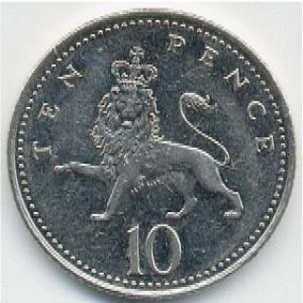
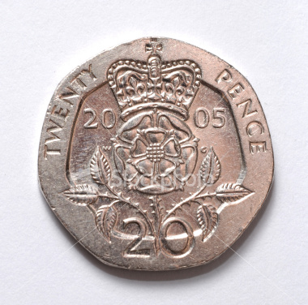
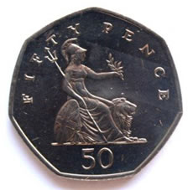
Coin Change Problem
Suppose we have 3 types of coins
10p
20p
50p
Minimum number of coins to make
£0.8, £1.0, £1.4 ?
Greedy method

Slide 2
Coin Change Problem
What if we have the following type of coins?
10p
50p
70p
10p
50p
70p
Minimum number of coins to make
£0.8, £1.0, £1.4 ?
Greedy method still works?

