Slide 1
Tools for Legal Argumentation: Current State of the Art
Tom Gordon
Fraunhofer FOKUS /
University of Potsdam

Slide 2
Outline
Overview of Legal Argumentation Tasks
Managing Sources and Evidence
Defining Argumentation Schemes
Modelling Laws and Cases
Constructing and Reconstructing Arguments
Evaluating and Comparing Arguments
Presenting Arguments

Slide 3
Factual and Legal Issues
Subsumption

Slide 4
Notes:
Gordon’s model

Slide 5
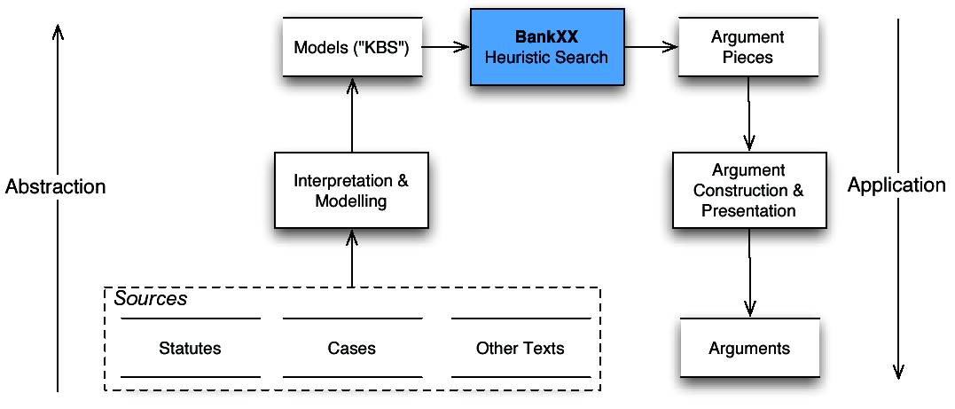
Bank XX (1993/96)
Rissland, Skalak & Friedman

Slide 6
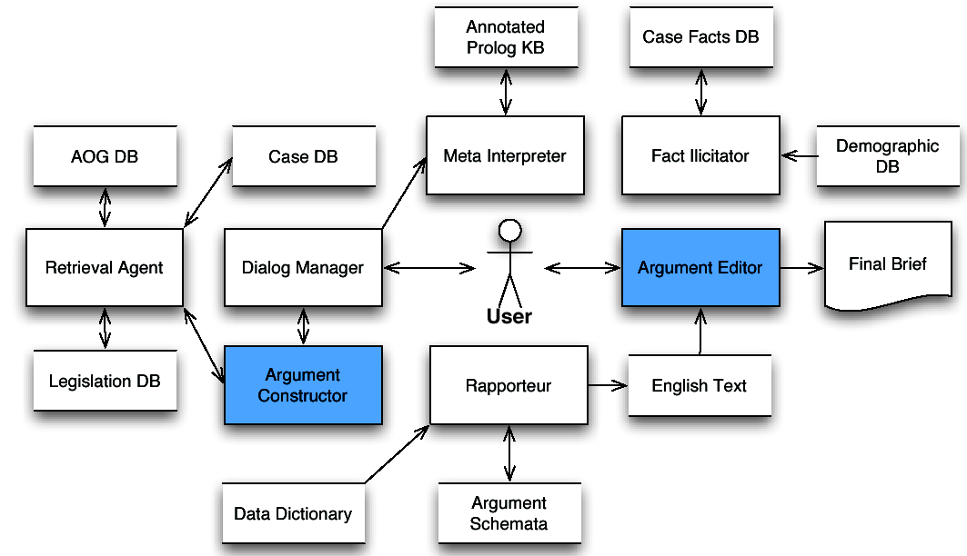
PLAID (1995)
Bench-Capon & Staniford
Notes:
- Uses a version of Toulmin’s argumentation scheme to construct arguments
- Research prototype, implemented in Prolog

Slide 7
Legal Argumentation Tasks
Notes:
Gordon’s model

Slide 8
Managing Sources and Evidence
Legal Research Services
  Google Scholar
  LexisNexis
  WestLaw
Content, Knowledge and Case Management Systems
  Alfresco
  Drupal
  Plone
Markup and Metadata
  CEN MetaLex
  Akoma Ntoso
  OASIS Legal Document XML

Slide 9
Legal Argumentation Tasks
Notes:
Gordon’s model

Slide 10
Computational Models of Argumentation Schemes
Argument from Cases (CBR) [McCarty, Ashley, Rissland, Branting, Skalak, Aleven, Roth]
Argument from Rules and Cases [Gardner, Branting, Skalak, Nitta, Prakken, Sartor, Bench-Capon]
Argument from Rules with Priorities [Hage, Verheij, Gordon, Prakken, Sartor]
Argument from Rationales [Loui, Norman, Roth]
Argument from Principles [Hage, Prakken, Gordon, Loui]
Argument from Values, Purpose and Policy [Berman, Hafner, Bench-Capon, Sartor]
Argument from Goals [Atkinson, Bench-Capon]
Argument from Evidence [Prakken, Walton]
Notes:
Authors are representative, not comprehensive

Slide 11
Argumentation Scheme Languages
Araucaria
Carneades
<SCHEME>
<NAME> Argument from Expert Opinion</NAME>
<FORM>
<PREMISE>E is an expert in domain D</PREMISE>
<PREMISE>E asserts that A is known to be true</PREMISE>
<PREMISE>A is within D</PREMISE>
<CONCLUSION>A may (plausibly) be taken to be true.</CONCLUSION>
</FORM>
<CQ>Is E a genuine expert in D?</CQ>
<CQ>Did E really assert that A is known to be true?</CQ>
<CQ>Is the expert's pronouncement directly quoted? If not, is a reference to the original source given? Can it be checked?
</CQ>
<CQ>If the expert advice is not quoted, does it look like important information or qualifications may have been left out?</CQ>
<CQ>If more than one expert source has been cited, is each authority quoted separately? Could there be disagreements among the cited authorities?</CQ>
<CQ>Is what the authority said clear? Are there technical terms used that are not explained clearly? If the advice is in layman's terms, could this be an indication that it has been translated from some other form of expression given by the expert?</CQ>
<CQ>Is A relevant to domain D?</CQ>
<CQ>Is A consistent with what other experts in D say?</CQ>
<CQ>Is A consistent with known evidence in D?</CQ>
</SCHEME>
(make-scheme
:id 'expert-opinion
:header (make-metadata
:title "Argument from Expert Opinion"
:source "Douglas Walton, Legal Argumentation and
Evidence, The Pennsylvania State University Press, University Park,
2002, pp.49-50. Douglas Walton, Appeal to Expert Opinion, The
Pennsylvania University Press, University Park, Albany, 1997,
p.211-225.")
:conclusion '?A
:premises [(make-premise
:role "major"
:statement '(expert ?E ?S))
(make-premise
:role "domain"
:statement '(in-domain ?A ?S))
(make-premise
:role "minor"
:statement '(asserts ?E ?A))]
;; Critical Questions
:exceptions [(make-premise
:role "CQ1"
:statement '(untrustworthy ?E))
(make-premise
:role "CQ2"
:statement '(inconsistent-with-other-experts ?A))]
:assumptions [(make-premise
:role "CQ3"
:statement '(based-on-evidence ?A))])
Notes:
Araucaria (2001) Rowe, Reed & Katzav

Slide 12
Legal Argumentation Tasks
Notes:
Gordon’s model

Slide 13
Modelling Laws
Isomorphism
Reification
Defeasibility
Contraposition
Open Texture
Rule Validity
Modalities
Notes:
Isomorphism. One-to-one correspondence between the structure and organization of the rules in the formal model and the structure of titles, chapters and sections of the legislation being modeled (Bench-Capon and Coenen 1992). Rules with separate exceptions, in other sections of the legal code, should not be merged into a single rule in the formal model.
Reification. Rules are objects with properties needed for resolving rule conflicts, such as the enacting legislative body (e.g. state or federal legislature), geographical coverage (jurisdiction), and various temporal properties (e.g. date of enactment, validity period), or the values (Bench-Capon 2002) promoted by the rules.
Defeasibility. When the antecedents (premises) of a legal rule hold in a particular case, there is an argument for the conclusion of the rule (Hage 1993; Gordon 1995; Prakken and Sartor 1996; Sartor 2005). The conclusion of this argument is presumably, but not necessarily true. The argument can be defeated in various ways).
Contraposition. Rules do not counterpose (Prakken and Sartor 1996). If the conclusion of a legal rule is false, the rule cannot be used backwards to draw conclusions about its premises.
Open Texture. Legal terms often have an "open texture” (Hart 1961). The courts will identify factors (Ashley 1990) to take into consideration when constructing arguments from analogy.
Rule Validity. Legal rules can be invalid or become invalid (Governatori and Rotolo 2009). Deleting invalid rules is not always an option. It can be necessary to apply rules, or versions of rules, which were valid at an earlier time.
Modalities. The conclusions of legal rules can be qualified in various ways, using "modalities" (Jones and Sergot 1992; Allen and Saxon 1993). For example, legal rules may apply "deontic" modalities (von Wright 1963) to define permissions, obligations or prohibitions or higher-level Hohfeldian relations such as rights, privileges, powers and immunities.

Slide 14
Some Rule Languages for
Modeling Laws
Defeasible Logic (Nute 1994; Governatori, Rotolo & Sartor 2005)
PRATOR (Prakken & Sartor 1996)
Legal Knowledge Interchange Format (Gordon et al. 2008 )
OASIS Legal RuleML (2013 ?)
Carneades Scheme Language (Gordon 2013)

Slide 15
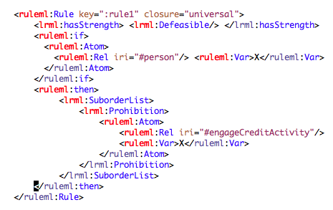
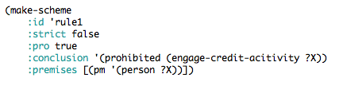
Example Rule
Legal RuleML
Carneades Scheme Language

Slide 16
Modeling Cases
Title
Court
Issue
Decision
Facts or Factors
Arguments (majority and minority)
Ratio Decidendi
Notes:
Ratio Decidendi: Legal rule derived from or consistent with the arguments of the majority.

Slide 17
HYPO Trade Secrets Example
CASE Yokana (∆)
F7 Brought-Tools (π)
F10 Secrets-Disclosed-Outsiders (∆)
F16 Info-Reverse-Engineerable (∆)
CASE American Precision (π)
F7 Brought-Tools (π)
F16 Info-Reverse-Engineerable (∆)
F21 Knew-Info-Confidential (π)
CASE Mason (CFS, Undecided)
F1 Disclosure-in-Negotiations (∆)
F6 Security-Measures (π)
F15 Unique-Product (π)
F16 Info-Reverse-Engineerable (∆)
F21 Knew-Info-Confidential (π
F10 (∆)
F9 (π)
Yokana (∆)
F7 (π)
Mason (?)
F16 (∆)
American
Precision (π)
F1 (∆)
F21 (π)
F6 (π)
CFS
F15 (π)
π = plaintiff
∆ = defendant
F19 (∆)
F18 (π)
Ashey, Kevin; Modeling Legal Argument: Reasoning with Cases and Hypotheticals; MIT Press; 1990.

Slide 18
Modelling Arguments in Court Opinions
Example: Popov v. Hayashi
  Gordon, T. F., and Walton, D. A Carneades Reconstruction of Popov v Hayashi. Artificial Intelligence and Law 20, 1 (2012), 37–56.
Notes:
E

Slide 19
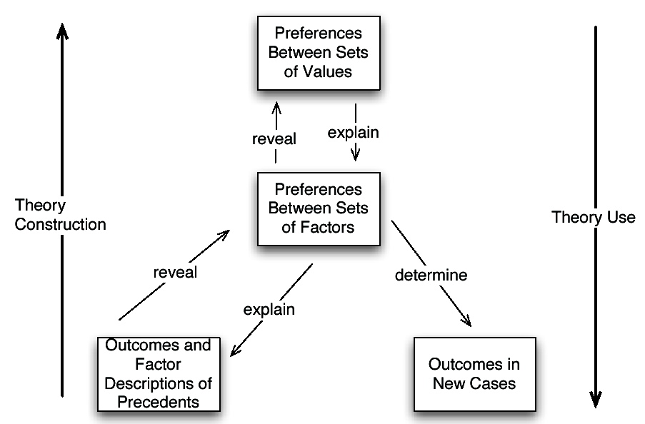
Ratio Decidendi: Theory Construction
  Bench-Capon, T., and Sartor, G. A Model of Legal Reasoning with Cases Incorporating Theories and Values. Artificial Intelligence 150, 1–2 (Nov. 2003), 97–143.

Slide 20
Legal Argumentation Tasks
Notes:
Gordon’s model

Slide 21
Constructing and Reconstructing Arguments
Compared
  Construction: creating original arguments by instantiating argumentation schemes
  Reconstruction: using argument schemes to interpret existing arguments in natural language texts (e.g. court opinions)
Kinds of Tools
  Interactive software tools
  Fully automatic, using models of, e.g., facts, ontologies, rules and cases

Slide 22
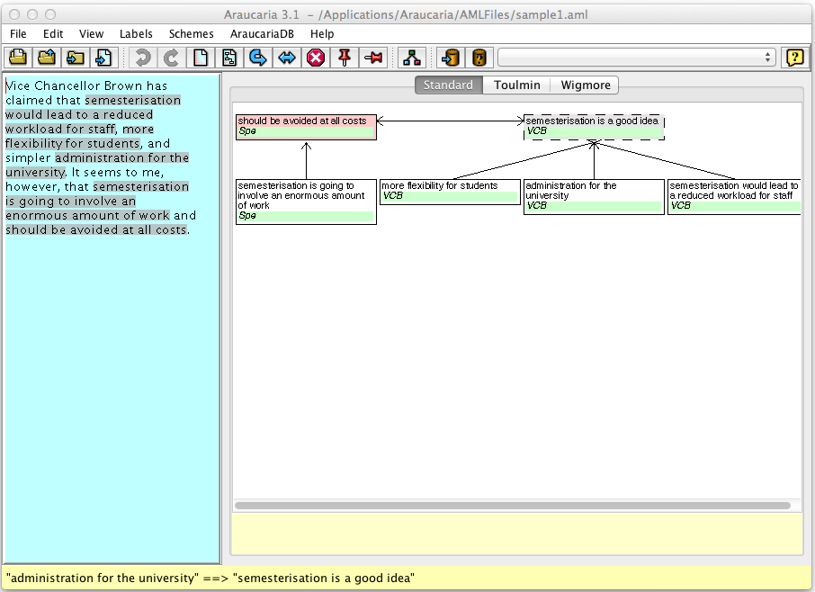
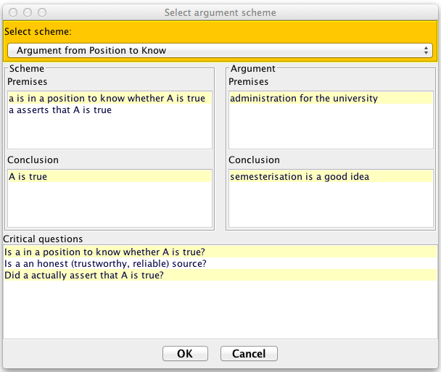
Interactive Argument Reconstruction with Araucaria
Rowe, Reed & Katzav (2001)
Notes:
Supports argument reconstruction and visualization
Diagram types: Beardsley/Freeman, Toulmin and Wigmore
Supports argumentation schemes.
Stores arguments in XML using the Argument Markup Language (AML) DTD.
- Open Source, Implemented in Java

Slide 23
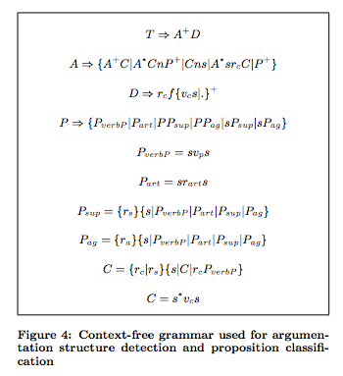
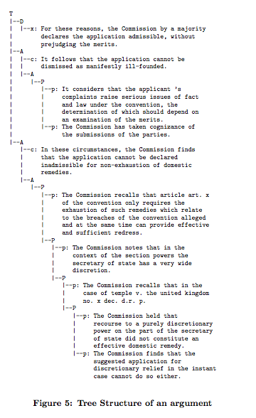
Argument Mining:
Automatic Argument Reconstruction
Palau, Raquel Mochales, and Marie-Francine Moens. "Argumentation mining: the detection, classification and structure of arguments in text." Proceedings of the 12th international conference on artificial intelligence and law. ACM, 2009.

Slide 24
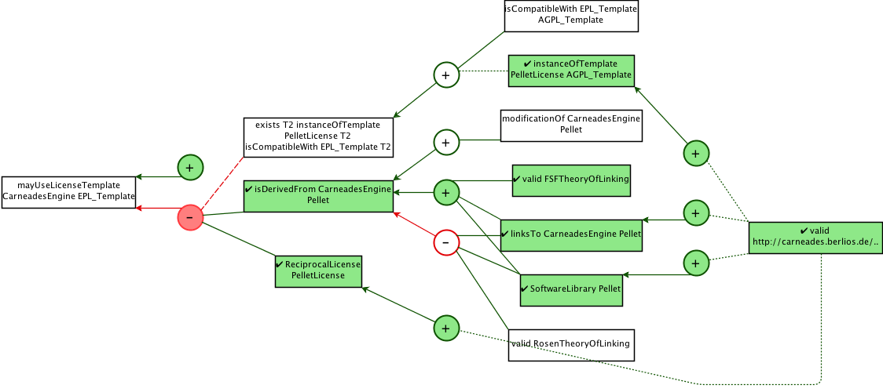
Automatic Argument Construction from Rules and Ontologies
  Gordon, T. F. Combining Rules and Ontologies with Carneades. In Proceedings of the 5th International RuleML2011@BRF Challenge (2011), pp. 103–110.
Notes:
This shows a simplified screen shot of the Carneades Editor

Slide 25
Legal Argumentation Tasks
Notes:
Gordon’s model

Slide 26
Evaluating Arguments:
Conceptions of Argument
Single-step arguments: Instantiations of argumentation schemes
Defeasible proofs (Pollock 1987; Prakken 2010)
Minor premise (Pragma-Dialectics)
Set of propositions (Bresnard & Hunter 2008)
Argument graphs (Gordon, Prakken & Walton 2007)
Notes:
Argument graphs generalize defeasible proofs to allow all the defeasible proofs for both sides to be represented in one graph.

Slide 27
Evaluating Arguments: Procedure
Validate that each single-step argument properly instantiates its scheme. Check for missing premises.
From the perspective of the audience of interest, such as a judge or jury, label the statements which are accepted as true, or rejected as false, without argument, and weigh/order the single-step arguments.
Narrower conception of evaluation: Evaluate the defeasible proofs in the argument graph to determine which arguments are acceptable (in), not acceptable (out) or undecided. Use this information to then compute, analogously, which of the statements (claims) are acceptable (in), not acceptable (out) or undecided.
Use argumentation schemes to reveal and critically question any implicit premises and to construct counterarguments.

Slide 28
Computational Models of Argument Evaluation
Narrow conception of evaluation:
Abstract Arguments
  Abstract Argumentation Frameworks (Dung 1995)
  Value-based Argumentation (Bench-Capon 2003)
  Using arguments about preferences (Modgil 2009)
Structured Arguments
  DefLog (Verheij, 2003)
  Using proof standards; Carneades (Gordon, Prakken & Walton 2007)
  Defeasible proof trees; ASPIC+ (Prakken 2010)
  Mapping Carneades to ASPIC+ (Gizjel & Prakken 2011)

Slide 29
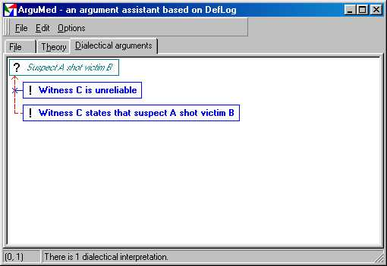
ArguMed (2001)
Verheij
Notes:
http://www.ai.rug.nl/~verheij/aaa/argumed1.htm
- Supports argument visualization and evaluation
- Semantics: DefLog
- Latest version: ArguMed 3 (2001).
- Implemented in Delphi (Windows only)

Slide 30
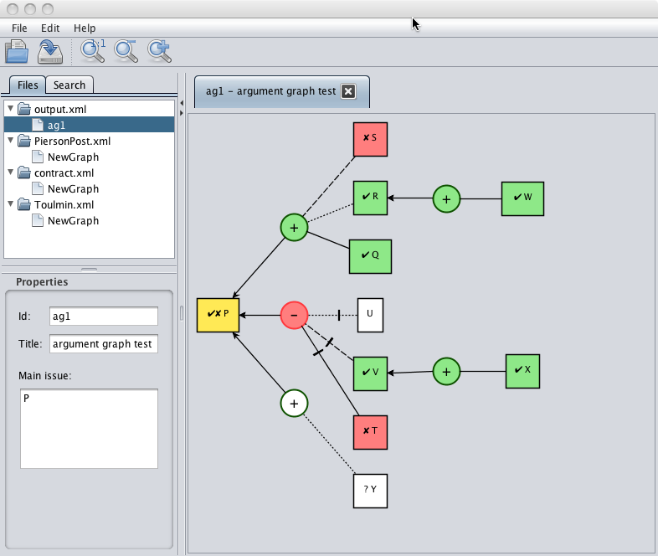
Carneades 2011
Notes:
single-user desktop application
platform: JVM
argument construction from conceptual models (ontologies), defeasible rules and argumentation schemes
- argument evaluation, using proof burdens and standards and a model of the audience
- finding positions to support claims, using abduction
- argument mapping and visualization
- argument interchange in XML, using the Legal Knowledge Interchange Format (LKIF)

Slide 31
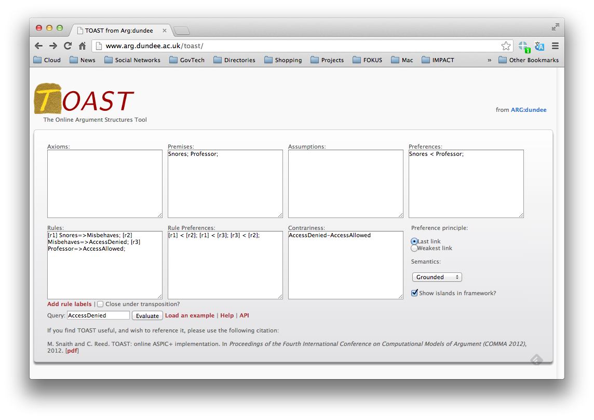
TOAST
(An Implementation of ASPIC+)
M. Snaith and C. Reed. TOAST: online ASPIC+ implementation. In Proceedings of the Fourth International Conference on Computational Models of Argument (COMMA 2012), 2012.

Slide 32
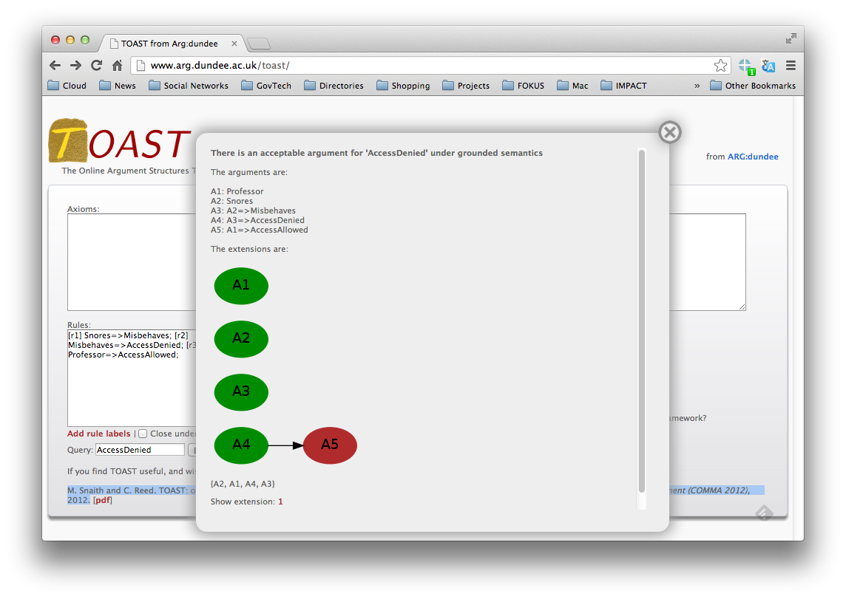
TOAST

Slide 33
Legal Argumentation Tasks
Notes:
Gordon’s model

Slide 34
Presenting Arguments
Textually
  Outlines
  Hypertext
  Reports, using “document assembly” tools (e.g. HotDocs, Exari)
Diagrams
  Argument maps

Slide 35
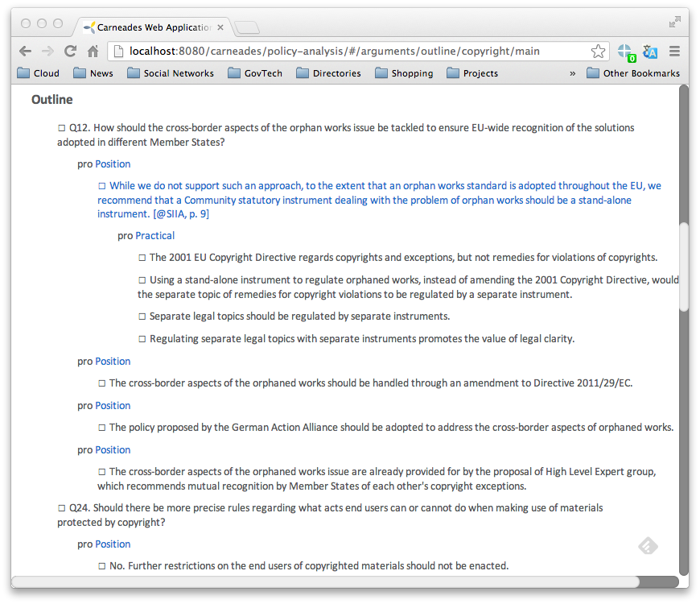
Hypertext Outline
Carneades Web App (2012)

Slide 36
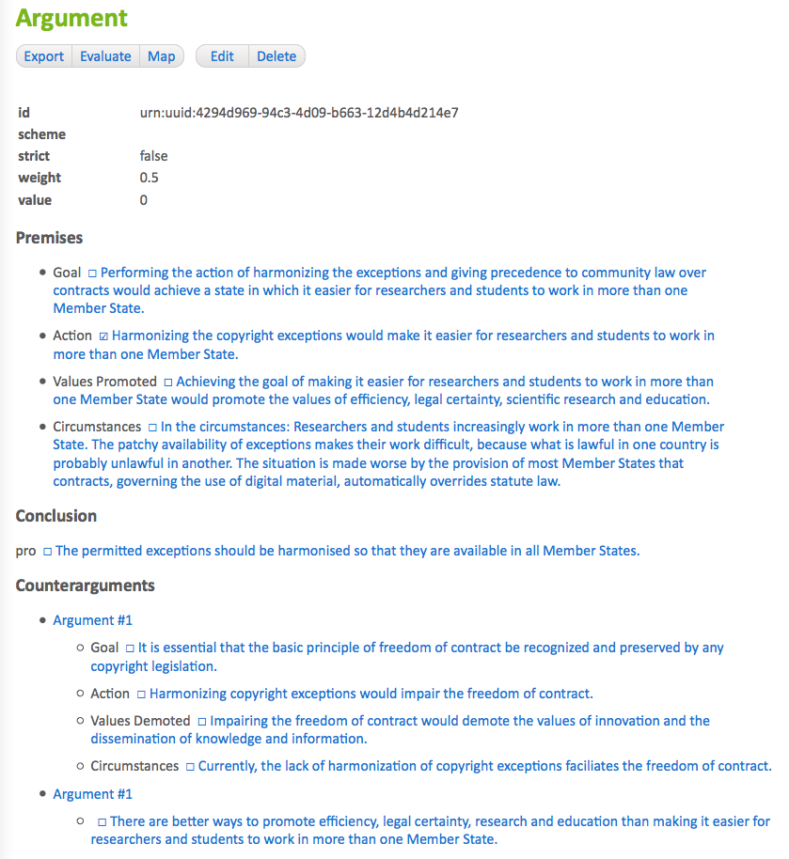
Detailed Argument View
Carneades Web App

Slide 37
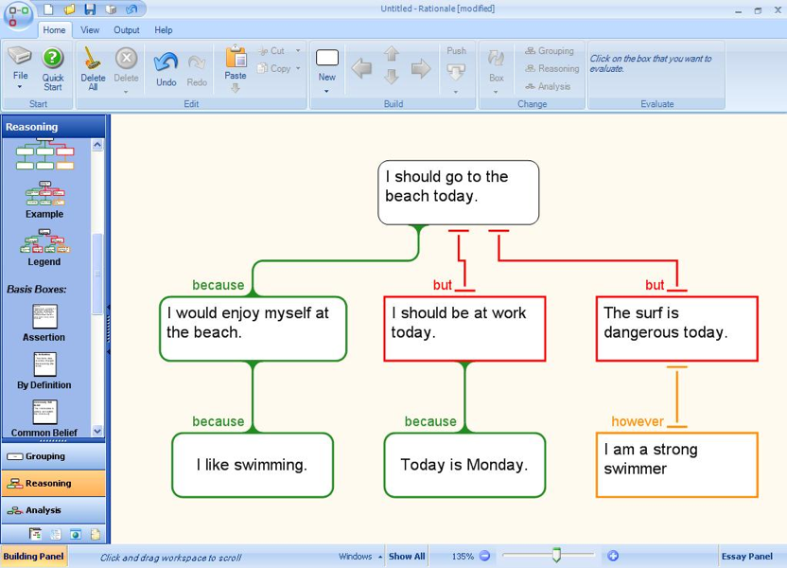
Rationale (2003)
Austhink
Notes:
- Commercial “Argument Mapping” product, by Austhink.
- Supports argument visualization and evaluation (“analysis”).
- Provides two types of diagrams:
“Reasoning maps, which lay out arguments in a quick and intuitive way”
“Analytical maps, which enable a more careful and rigorous analysis of an argument.”
- Successor to Reasonable!
- Platform: A .Net application (Windows only).

Slide 38
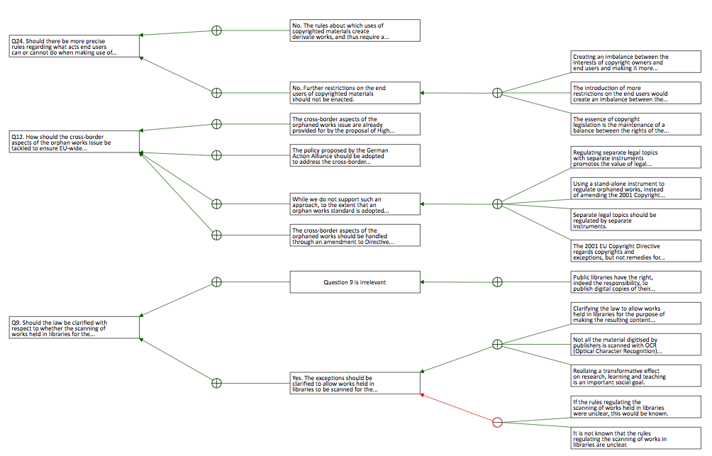
Carneades Argument Map
Web App Version

Slide 39
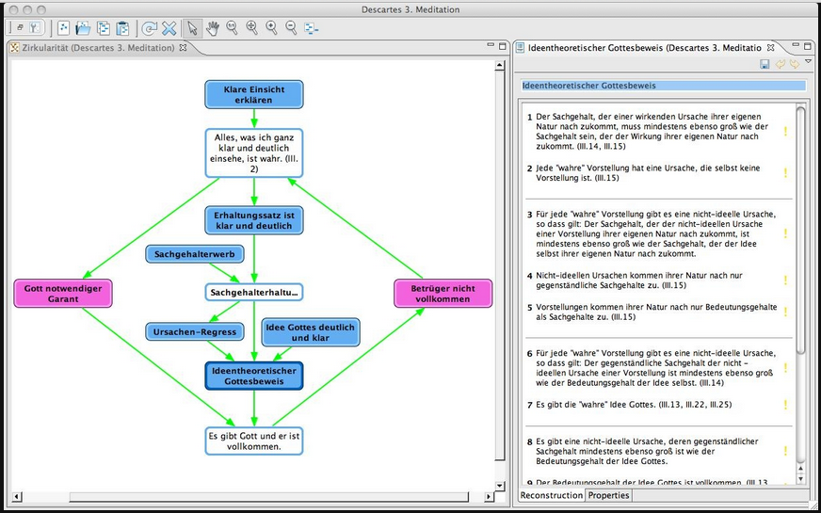
ArguNet (Betz)
http://www.argunet.org

Slide 40
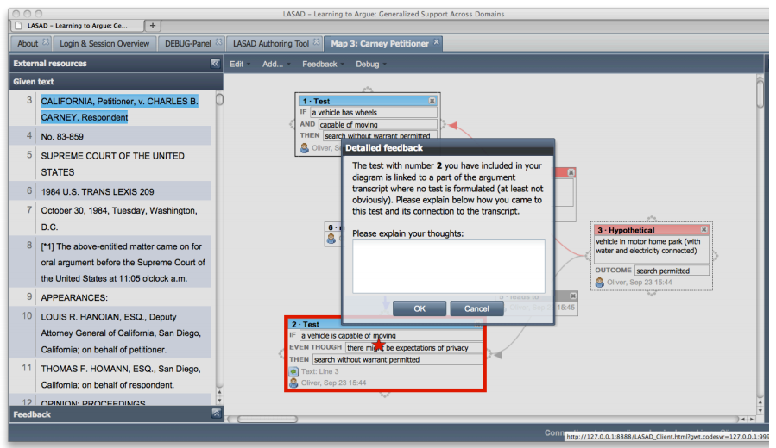
LASAD
Loll, Frank, and Niels Pinkwart. "LASAD: Flexible representations for computer-based collaborative argumentation." International Journal of Human-Computer Studies (2012).

Slide 41
Tasks Not Covered
Notes:
Gordon’s model

