Slide 1
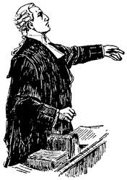
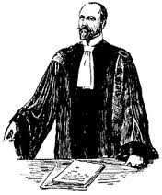
Arguing with Legal Cases: what do we know?
Trevor Bench-Capon
Department of Computer Science
University of Liverpool
UK

Slide 2
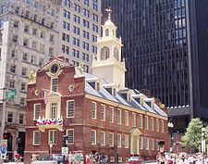
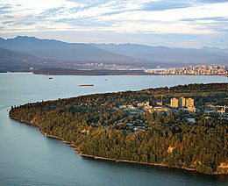
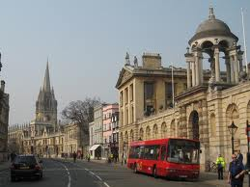
Landmarks – Part I
Taxman: Thorne McCarty
Theory Construction, Prototypes and Deformations
Eisner v Macomber (Tax Law Case)
HYPO: Edwina Rissland and Kevin Ashley
Three Ply Argument, Dimensions
US Trade Secret Law

Slide 3
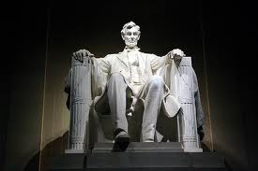
Landmarks – Part 2
CABARET: Edwina Rissland and David Skalak
Top Level of Rules, Argument Moves
Home Office Deduction
CATO: Kevin Ashley and Vincent Aleven
Factors, Abstract Factors, Down-Playing
US Trade Secret Law
ICAIL 1993: Don Berman and Carole Hafner
Purpose, Teleological Reasoning
Pierson v Post, Keeble v Hickersgill, Young v Hitchens
The Wild Animals Cases

Slide 4
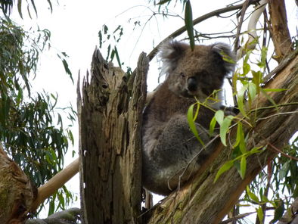
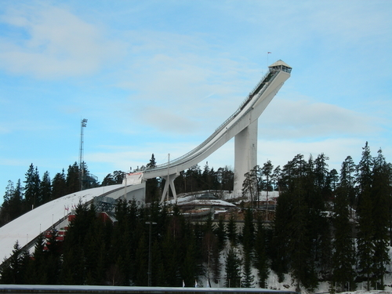
Landmarks – Part 3
Rule Based Representation of Precedent: Henry Prakken and Giovanni Sartor
Precedents represented as three rules: plaintiff rule, defendant rule and priority between them
Residence example (Fictional)
Value Based Theories: Trevor Bench-Capon and Giovanni Sartor and Henry Prakken
Rule Preferences explained as value preferences, Theory Constructors
Wild Animals Cases

Slide 5
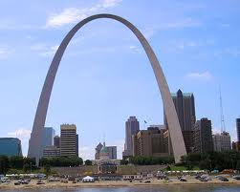
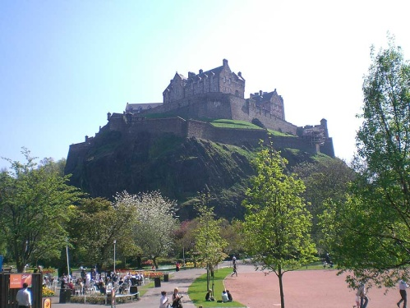
Landmarks – Part 4
IBP: Stefanie Bruninghaus and Kevin Ashley
Top Level of Issues: Prediction
US Trade Secrets Law
Argumentation Schemes: Adam Wyner, Katie Atkinson, Trevor Bench-Capon, Henry Prakken
Reasoning with Cases as Practical Reasoning
Reconstruction of CATO using Argumentation Schemes
Wild Animals + Popov v Hayashi

Slide 6
Some Other Approaches – Part 1
GREBE: Karl Branting
Semantic Networks
Industrial Injury
Neural Networks:
Daniele Bourcier
Trevor Bench-Capon
Hospital Visit Benefit (fictional)

Slide 7
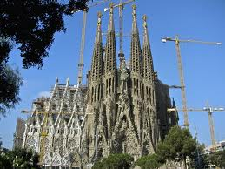
Some Other Approaches – Part 2
BANKXX: Edwina Rissland, David Skalak and M. Timur Friedman
Assembling Arguments through Heuristic Search
US Bankruptcy Law
AGATHA: Alison Chorley and Trevor Bench-Capon
Constructing Theories as an Adversarial Game
Wild Animals, US Trade Secrets

Slide 8
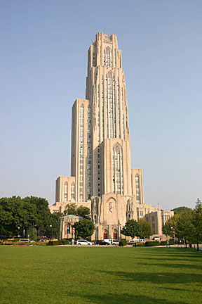
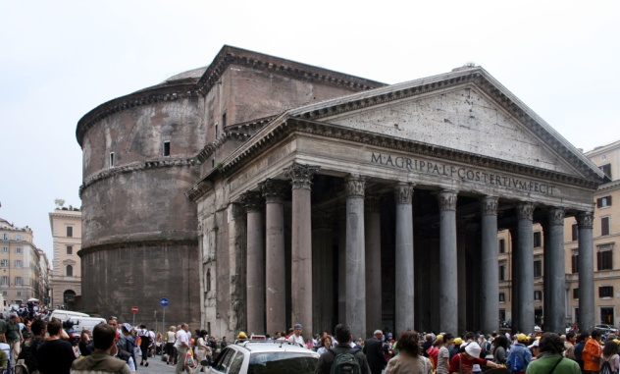
Some Other Approaches – Part 3
Tangled Hierarchies: Bram Roth and Bart Verheij
Attacks on connections as well as factors
Dutch Employment Law
Evidence: Floris Bex, Peter van Koppen, Susan van den Braak, Henry Prakken and BartVerheij
Resolving conflicting witness testimony
Criminal cases

Slide 9
The Problem
Given a set of decided cases, and a new (current) case: how do we construct and compare arguments about how the new case?
Some Issues:
Where do we start?: facts (higher courts) or evidence (lower courts)?
How do we represent cases? Facts, Dimensions, Factors, Issues, Purposes, Values.
How do we compare cases?
How do we go beyond a fortiori reasoning?

Slide 10
From Evidence to Decision
Legal Consequences
Intermediates
Facts
Ross,
Lindahl
Evidence

Slide 11
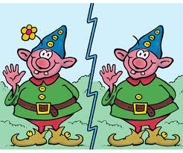
What makes cases similar?
Not closeness of fact
Woman of 60
Woman of 59
Not similar
Woman of 60
Man of 65
Similar
Woman of 62
Man of 62
Not Similar
Woman of 98
Man of 67
Similar
So cannot use standard techniques
like least squares

Slide 12
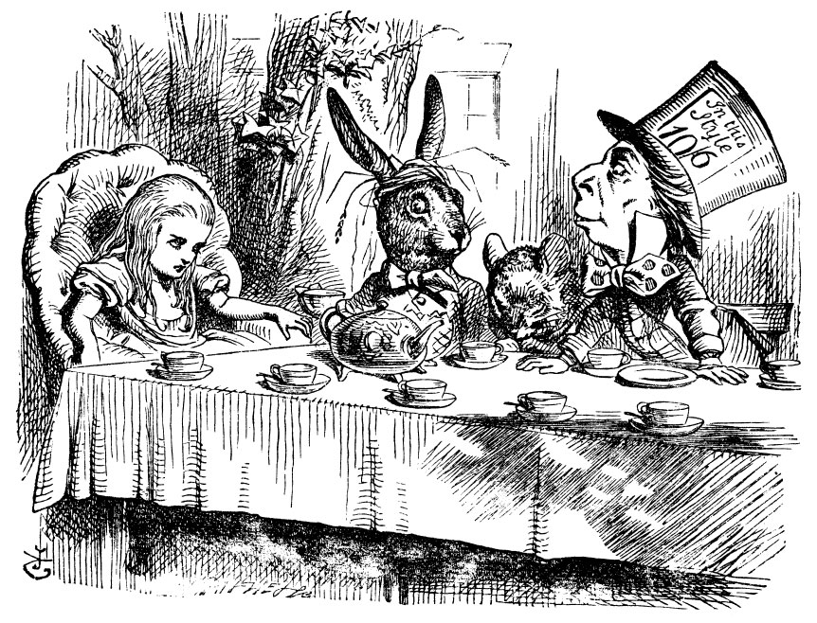
Why is a raven like a writing desk?
That is from Lewis Carrol’s Alice in Wonderland, but there are real cases in which match:
A fox
A shoal of fish
A baseball
All being pursued
A lemonade bottle
A coffee urn
A car with a loose wheel
All imminently dangerous
Facts are unique
to their cases
We need abstractions
which are legally
relevant
Factors provide
such abstractions

Slide 13
CATO
System
Outcomes
Vincent
Factors
Analysis
Case Decisions

Slide 14
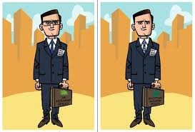
Factors
Legally relevant features of cases: abstract from many, disparate, fact patterns
Emerge from case law
Judges relate to previous decisions through similar language: these are the factors
Favour one side or the other
Unlike dimensions
Are determined by analysis
Attempts to automate largely unsuccessful (e.g. SMILE, Bruninghaus and Ashley)

Slide 15
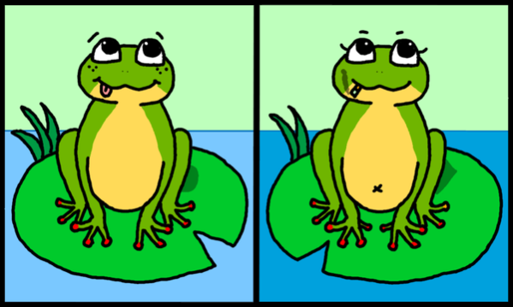
Factor Based Reasoning
Cases are represented as sets of factors
One step of inference:
Antecedent is a conjunction of factors
Consequent is an outcome
Exact matches are rare: precedents are distinguished when
a precedent is cited for the one side
the precedent is stronger for that side
the current case is weaker for that side

Slide 16
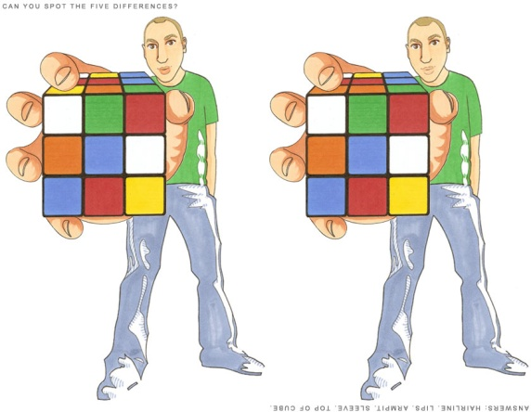
Factors May Result In
An a fortiori argument for one side
Precedent which cannot be distinguished: all opposing precedents can be distinguished
(a,b,c: ?): (a,b: plaintiff) : (a,b,d: defendant)
Arguments for both sides
No a fortiori precedent for either side
Distinguishable precedents for one or both sides
How do we extend our theory to choose between competing arguments?

Slide 17
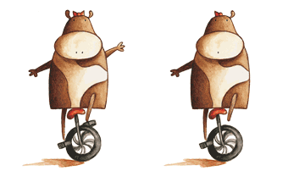
Beyond A Fortiori
CATO – Abstract Factor Hierarchy
Factors are children of more abstract factors
Factors may be reasons for or against the presence of their parent
NOT an IS-A hierachy
Children factors may substitute for or cancel one another (downplaying)

Slide 18
Value Based Theory Construction
Factors are associated with social values (purposes)
Deciding for the part favoured by the factor would promote the value
Precedents express preferences between values
These value preferences form a theory which explains the past decisions (more or less well)
We choose the best theory
The theory is applied to the current case
Can also be independent arguments for value preferences

Slide 19
Horty and Bench-Capon (2012)
In Prakken and Sartor (1998) both the plaintiff and the defendant rules were as strong as possible (used all the factors)
In Horty and Bench-Capon (2012) the rule for the winning side may be weaker (use only a subset of the factors)
This means that it can apply to more cases
But can only be justified by success

Slide 20
Organising Factors
Often cases are seen as sets of factors. But often too there is some organisation into topics or issues.
CABARET: Top level logical expression representing the statute rule
Factors interpret the terms of the statute
IBP: Top level logical “model” (from Restatement of Torts)
Factors are partitioned into issues to resolve the terms of the model
Theory Construction: Factors relate to values
Factors determine which values can be promoted: preferences decide which values will be promoted

Slide 21
Organising Arguments
Three Ply Argument (HYPO, CATO)
Citation
Distinguishing and Counter Examples
Rebuttal: Distinguishing Counter Examples etc.
Dialectic Tree (e.g. Prakken and Sartor)
Argument for
Argument against
And so on
Cascade of Argumentation Schemes (e.g. Wyner et al)
Top Level Scheme
Schemes to establish premises of higher schemes
Schemes to undercut higher schemes

Slide 22
What About Dimensions?
Factors as Points on Dimensions:
F1
F2
F3
F4
F5
P
D
?
?
Where does the cross over point come?
Where do factors come from? Which side do they favour?

Slide 23
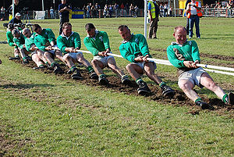
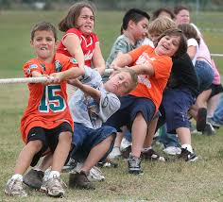
Other Roles for Dimensions?
Perhaps Dimensions connect to
Abstract Factors?
Issues?
Values?
Elements in Tests?

Slide 24
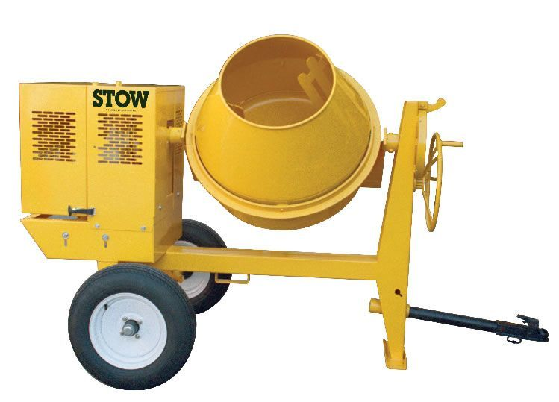
How do Factors Combine?
Using Logical Connectives?
Top Level provides Necessary and Sufficient Conditions
Top Level Provides Argument – some elements may be missing
“Considerations “
The factors need to be weighed against one another and a judgement made
Similar considerations apply to Values
And how do we compare sets of Values?

Slide 25
Summary
We understand reasoning from factors to outcomes reasonably well
Why we need factors
The logic of precedent
Where factors fit in the overall process
We have some understanding of what we need to investigate
We have some ideas about how to go about these investigations
We have no clarity or consensus on these areas

