Slide 1
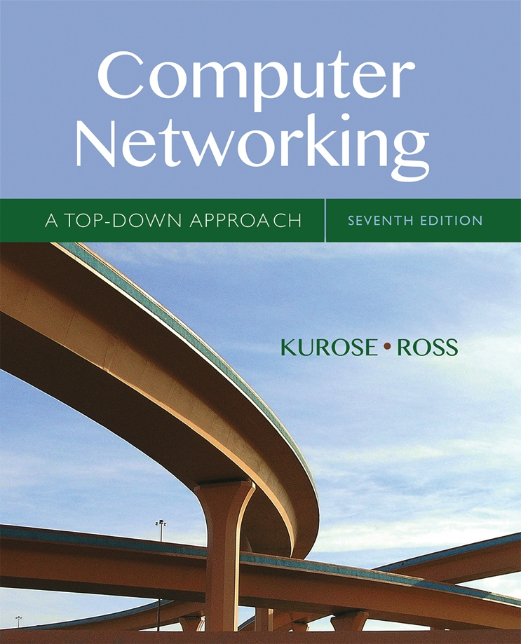

COMP211
Chapter 6/7
Link Layer
Computer Networking: A Top Down Approach
7th edition
Jim Kurose, Keith Ross
Pearson/Addison Wesley
April 2016
All material copyright 1996-2012
J.F Kurose and K.W. Ross, All Rights Reserved

Slide 2
Chapter 5/6: Link layer
our goals:
understand principles behind link layer services:
  error detection, correction
  sharing a broadcast channel: multiple access
  link layer addressing
  local area networks: Ethernet, WLAN
instantiation, implementation of various link layer technologies

Slide 3
Link layer, LANs: outline
6.1 introduction, services
6.2 error detection, correction
6.3 multiple access protocols
6.4 LANs
  addressing, ARP
  Ethernet
  switches
7 Wireless Links and WLAN (Ch. 7)
6.7 a day in the life of a web request

Slide 4













Link layer: introduction
terminology:
hosts and routers: nodes
communication channels that connect adjacent nodes along communication path: links
  wired links
  wireless links
  LANs
layer-2 packet: frame, encapsulates datagram
global ISP
data-link layer has responsibility of
transferring datagram from one node
to physically adjacent node over a link

Slide 5
Link layer: context
datagram transferred by different link protocols over different links:
  e.g., Ethernet on first link, frame relay on intermediate links, 802.11 on last link
each link protocol provides different services
  e.g., may or may not provide rdt over link
transportation analogy:
trip from Princeton to Lausanne
  limo: Princeton to JFK
  plane: JFK to Geneva
  train: Geneva to Lausanne
tourist = datagram
transport segment = communication link
transportation mode = link layer protocol
travel agent = routing algorithm

Slide 6
Link layer services
framing, link access:
  encapsulate datagram into frame, adding header, trailer
  channel access if shared medium
  “MAC” addresses used in frame headers to identify source, dest
    different from IP address!
reliable delivery between adjacent nodes
  we learned how to do this already (chapter 3)!
  seldom used on low bit-error link (fiber, some twisted pair)
  wireless links: high error rates
    Q: why both link-level and end-end reliability?

Slide 7
Link layer services (more)
flow control:
  pacing between adjacent sending and receiving nodes
error detection:
  errors caused by signal attenuation, noise.
  receiver detects presence of errors:
    signals sender for retransmission or drops frame
error correction:
  receiver identifies and corrects bit error(s) without resorting to retransmission

Slide 8
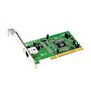
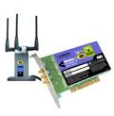

Where is the link layer implemented?
in each and every host
link layer implemented in “adaptor” (aka network interface card NIC) or on a chip
  Ethernet card, 802.11 card; Ethernet chipset
  implements link, physical layer
attaches into host’s system buses
combination of hardware, software, firmware
application
transport
network
link
cpu
memory
link
physical
host
bus
(e.g., PCI)
controller
physical
transmission
network adapter
card

Slide 9
Adaptors communicating
datagram
datagram
controller
controller
sending host
receiving host
datagram
frame
sending side:
  encapsulates datagram in frame
  adds error checking bits, rdt, flow control, etc.
receiving side
  looks for errors, rdt, flow control, etc
  extracts datagram, passes to upper layer at receiving side

Slide 10
Link layer, LANs: outline
6.1 introduction, services
6.2 error detection, correction
6.3 multiple access protocols
6.4 LANs
  addressing, ARP
  Ethernet
  switches
7 Wireless Links and WLAN (Ch. 7)
6.7 a day in the life of a web request

Slide 11
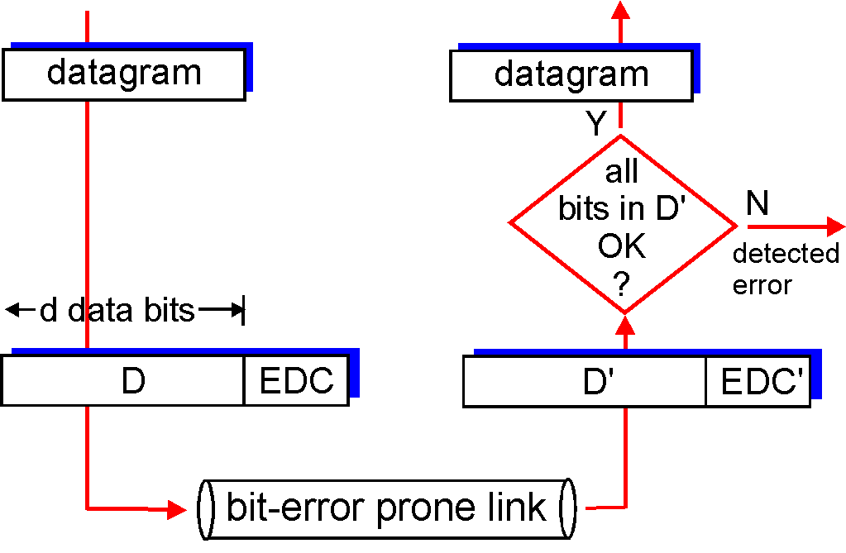
Error detection
EDC= Error Detection and Correction bits (redundancy)
D = Data protected by error checking, may include header fields
Error detection not 100% reliable!
  protocol may miss some errors, but rarely
  larger EDC field yields better detection and correction
otherwise

Slide 12
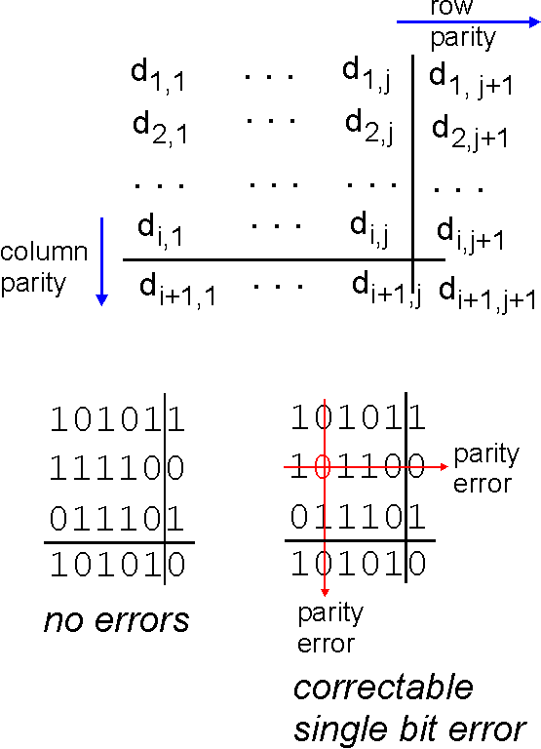
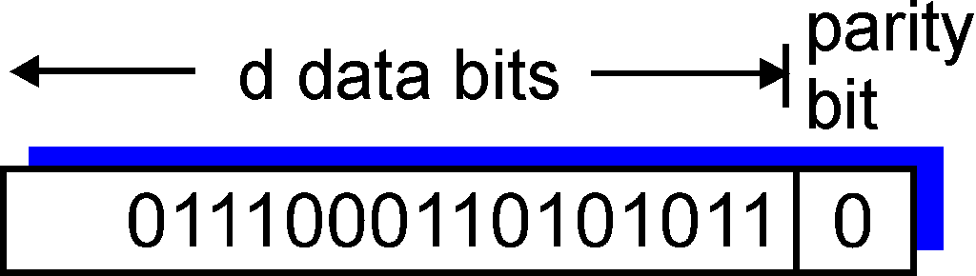
Parity checking
single bit parity:
detect single bit errors
two-dimensional bit parity:
detect and correct single bit errors
0
0

Slide 13
Internet checksum (review)
goal: detect “errors” (e.g., flipped bits) in transmitted packet (note: used at transport layer only)
sender:
treat segment contents as sequence of 16-bit integers
checksum: addition (1’s complement sum) of segment contents
sender puts checksum value into UDP checksum field
receiver:
compute checksum of received segment
check if computed checksum equals checksum field value:
  NO - error detected
  YES - no error detected. But maybe errors nonetheless?

Slide 14
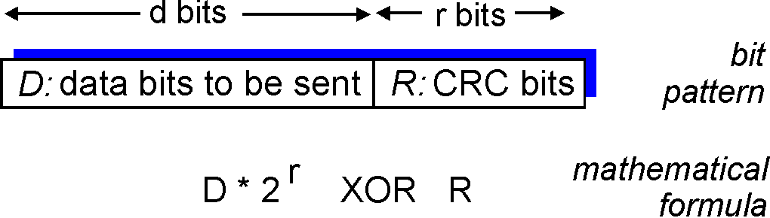
Cyclic redundancy check
more powerful error-detection coding
view data bits, D, as a binary number
choose r+1 bit pattern (generator), G
goal: choose r CRC bits, R, such that
  <D,R> exactly divisible by G (modulo 2)
  receiver knows G, divides <D,R> by G. If non-zero remainder: error detected!
  can detect all burst errors less than r+1 bits
widely used in practice (Ethernet, 802.11 WiFi, ATM)

Slide 15
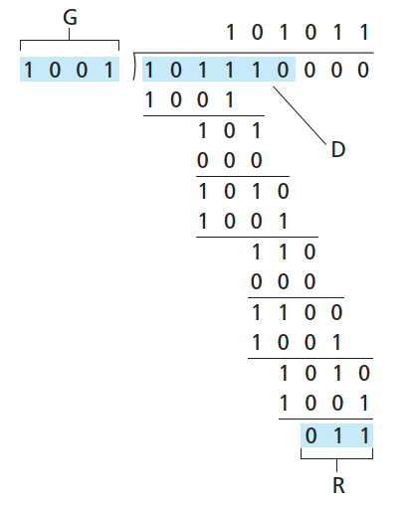
CRC example
r = 3
want:
  D.2^{r} XOR R = nG
equivalently:
  D.2^{r} = nG XOR R
equivalently:
if we divide D.2^{r} by G, want remainder R to satisfy:
D.2^{r}
G
R = remainder[ ]

Slide 16
Link layer, LANs: outline
6.1 introduction, services
6.2 error detection, correction
6.3 multiple access protocols
6.4 LANs
  addressing, ARP
  Ethernet
  switches
7 Wireless Links and WLAN (Ch. 7)
6.7 a day in the life of a web request

Slide 17



Multiple access links, protocols
two types of “links”:
point-to-point
  PPP for dial-up access
  point-to-point link between Ethernet switch, host
broadcast (shared wire or medium)
  old-fashioned Ethernet
  upstream HFC
  802.11 wireless LAN
shared wire (e.g.,
cabled Ethernet)
shared RF
(e.g., 802.11 WiFi)
shared RF
(satellite)
humans at a
cocktail party
(shared air, acoustical)

Slide 18
Multiple access protocols
single shared broadcast channel
two or more simultaneous transmissions by nodes: interference
  collision if node receives two or more signals at the same time
multiple access protocol
distributed algorithm that determines how nodes share channel, i.e., determine when node can transmit
communication about channel sharing must use channel itself!
  no out-of-band channel for coordination

Slide 19
An ideal multiple access protocol
given: broadcast channel of rate R bps
desiderata:
  1. when one node wants to transmit, it can send at rate R.
  2. when M nodes want to transmit, each can send at average rate R/M
  3. fully decentralized:
    no special node to coordinate transmissions
    no synchronization of clocks, slots
  4. simple

Slide 20
MAC protocols: taxonomy
three broad classes:
channel partitioning
  divide channel into smaller “pieces” (time slots, frequency, code)
  allocate piece to node for exclusive use
random access
  channel not divided, allow collisions
  “recover” from collisions
“taking turns”
  nodes take turns, but nodes with more to send can take longer turns

Slide 21
Channel partitioning MAC protocols: TDMA
TDMA: time division multiple access
access to channel in "rounds"
each station gets fixed length slot (length = pkt trans time) in each round
unused slots go idle
example: 6-station LAN, 1,3,4 have pkt, slots 2,5,6 idle
6-slot
frame
6-slot
frame
1
3
4
1
3
4

Slide 22
Channel partitioning MAC protocols: FDMA
FDMA: frequency division multiple access
channel spectrum divided into frequency bands
each station assigned fixed frequency band
unused transmission time in frequency bands go idle
example: 6-station LAN, 1,3,4 have pkt, frequency bands 2,5,6 idle
time
frequency bands
FDM cable

Slide 23
Random access protocols
when node has packet to send
  transmit at full channel data rate R.
  no a priori coordination among nodes
two or more transmitting nodes ➜ “collision”,
random access MAC protocol specifies:
  how to detect collisions
  how to recover from collisions (e.g., via delayed retransmissions)
examples of random access MAC protocols:
  slotted ALOHA
  ALOHA
  CSMA, CSMA/CD, CSMA/CA

Slide 24
Slotted ALOHA
assumptions:
all frames same size
time divided into equal size slots (time to transmit 1 frame)
nodes start to transmit only at beginnings of slots
nodes are synchronized
if 2 or more nodes transmit in slot, all nodes detect collision
operation:
when node obtains fresh frame, transmits in next slot
  if no collision: node can send new frame in next slot
  if collision: node retransmits frame in each subsequent slot with prob. p until success

Slide 25
Slotted ALOHA
node 1
1
1
1
1
node 2
2
2
2
node 3
3
3
3
C
E
C
S
E
C
E
S
S
Pros:
single active node can continuously transmit at full rate of channel
highly decentralized: only slots in nodes need to be in sync
simple
Cons:
collisions, wasting slots
idle slots
nodes may be able to detect collision in less than time to transmit packet
clock synchronization

Slide 26
CSMA (carrier sense multiple access)
CSMA: listen before transmit:
if channel sensed idle: transmit entire frame
if channel sensed busy, defer transmission
human analogy: don’t interrupt others!

Slide 27
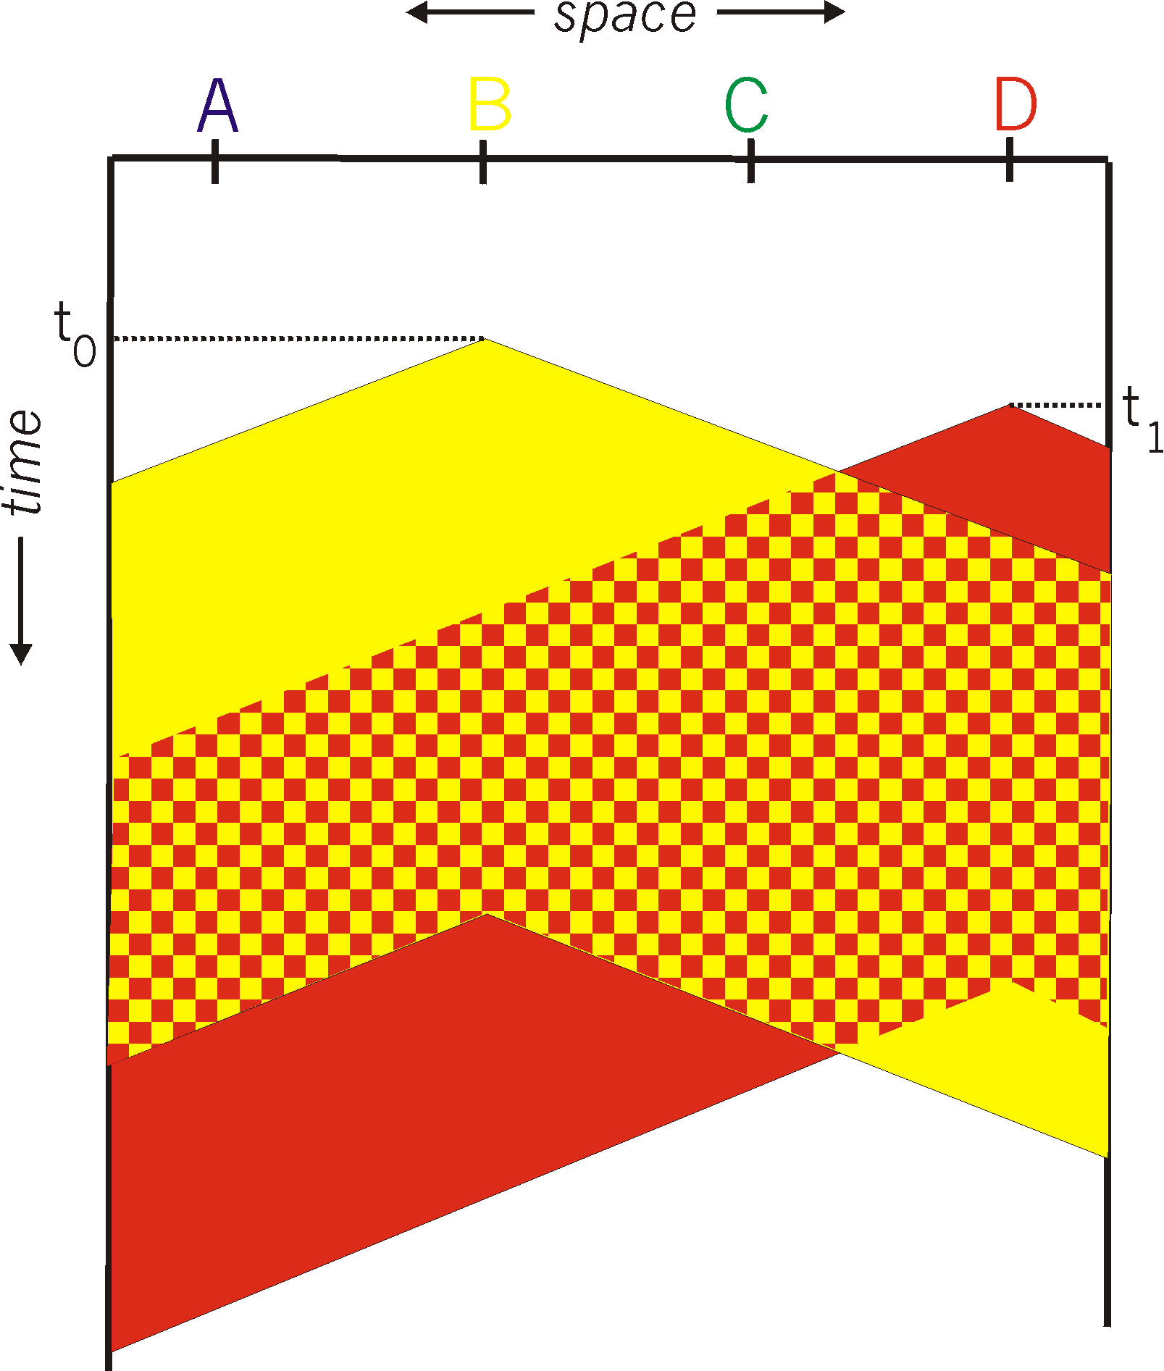
CSMA collisions
spatial layout of nodes
collisions can still occur: propagation delay means two nodes may not hear each other’s transmission
collision: entire packet transmission time wasted
  distance & propagation delay play role in in determining collision probability

Slide 28
CSMA/CD (collision detection)
CSMA/CD: carrier sensing, deferral as in CSMA
  collisions detected within short time
  colliding transmissions aborted, reducing channel wastage
collision detection:
  easy in wired LANs: measure signal strengths, compare transmitted, received signals
  difficult in wireless LANs: received signal strength overwhelmed by local transmission strength
human analogy: the polite conversationalist

Slide 29
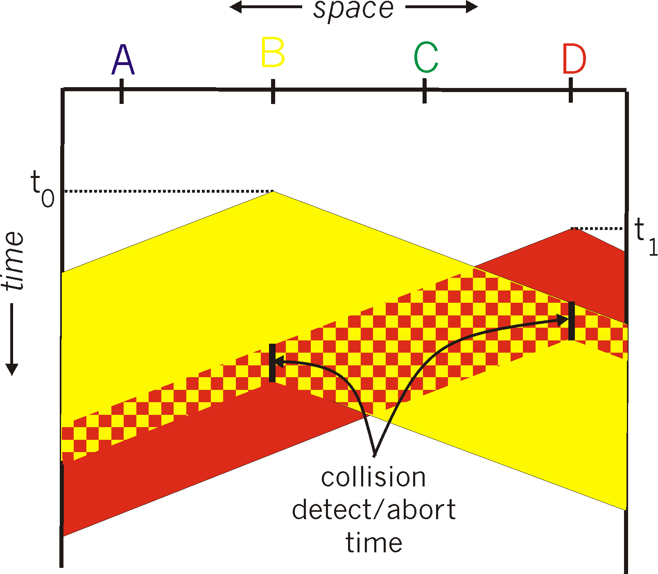
CSMA/CD (collision detection)
spatial layout of nodes

Slide 30
Ethernet CSMA/CD algorithm
1. NIC receives datagram from network layer, creates frame
2. If NIC senses channel idle, starts frame transmission. If NIC senses channel busy, waits until channel idle, then transmits.
3. If NIC transmits entire frame without detecting another transmission, NIC is done with frame !
4. If NIC detects another transmission while transmitting, aborts and sends jam signal
5. After aborting, NIC enters binary (exponential) backoff:
  after mth collision, NIC chooses K at random from {0,1,2, …, 2^{m}-1}. NIC waits K·512 bit times, returns to Step 2
  longer backoff interval with more collisions

Slide 31
“Taking turns” MAC protocols
channel partitioning MAC protocols:
  share channel efficiently and fairly at high load
  inefficient at low load: delay in channel access, 1/N bandwidth allocated even if only 1 active node!
random access MAC protocols
  efficient at low load: single node can fully utilize channel
  high load: collision overhead
“taking turns” protocols
  look for best of both worlds!

Slide 32
“Taking turns” MAC protocols
polling:
master node “invites” slave nodes to transmit in turn
typically used with “dumb” slave devices
concerns:
  polling overhead
  latency
  single point of failure (master)
data
poll
master
data
slaves

Slide 33
“Taking turns” MAC protocols
token passing:
control token passed from one node to next sequentially.
token message
concerns:
  token overhead
  latency
  single point of failure (token)
T
(nothing
to send)
T
data

Slide 34
Summary of MAC protocols
channel partitioning, by time, frequency or code
  Time Division, Frequency Division
random access (dynamic),
  ALOHA, S-ALOHA, CSMA, CSMA/CD
  carrier sensing: easy in some technologies (wire), hard in others (wireless)
  CSMA/CD used in Ethernet
  CSMA/CA used in 802.11
taking turns
  polling from central site, token passing
  Bluetooth, IBM token ring

Slide 35
Link layer, LANs: outline
6.1 introduction, services
6.2 error detection, correction
6.3 multiple access protocols
6.4 LANs
  addressing, ARP
  Ethernet
  switches
7 Wireless Links and WLAN (Ch. 7)
6.7 a day in the life of a web request

Slide 36
MAC addresses and ARP
32-bit IP address:
  network-layer address for interface
  used for layer 3 (network layer) forwarding
MAC (or LAN or physical or Ethernet) address:
  function: used ‘locally” to get frame from one interface to another physically-connected interface (same network, in IP-addressing sense)
  48 bit MAC address (for most LANs) burned in NIC ROM, also sometimes software settable
  e.g.: 1A-2F-BB-76-09-AD
hexadecimal (base 16) notation
(each “number” represents 4 bits)

Slide 37
MAC addresses and ARP
each adapter on LAN has unique MAC address
1A-2F-BB-76-09-AD
LAN
(wired or
wireless)
adapter
71-65-F7-2B-08-53
58-23-D7-FA-20-B0
0C-C4-11-6F-E3-98

Slide 38
LAN addresses (more)
MAC address allocation administered by IEEE
manufacturer buys portion of MAC address space (to assure uniqueness)
analogy:
  MAC address: like National Insurance Number
  IP address: like postal address
MAC flat address ➜ portability
  can move LAN card from one LAN to another
IP hierarchical address not portable
  address depends on IP subnet to which node is attached

Slide 39


ARP: address resolution protocol
Question: how to determine
interface’s MAC address, knowing its IP address?
ARP table: each IP node (host, router) on LAN has table
  IP/MAC address mappings for some LAN nodes:
< IP address; MAC address; TTL>
  TTL (Time To Live): time after which address mapping will be forgotten (typically 20 min)
137.196.7.78
1A-2F-BB-76-09-AD
137.196.7.23
137.196.7.14
LAN
71-65-F7-2B-08-53
58-23-D7-FA-20-B0
0C-C4-11-6F-E3-98
137.196.7.88

Slide 40
ARP protocol: same LAN
A wants to send datagram to B
  B’s MAC address not in A’s ARP table.
A broadcasts ARP query packet, containing B's IP address
  dest MAC address = FF-FF-FF-FF-FF-FF
  all nodes on LAN receive ARP query
B receives ARP packet, replies to A with its (B's) MAC address
  frame sent to A’s MAC address (unicast)
A caches (saves) IP-to-MAC address pair in its ARP table until information becomes old (times out)
  soft state: information that times out (goes away) unless refreshed
ARP is “plug-and-play”:
  nodes create their ARP tables without intervention from net administrator

Slide 41
Link layer, LANs: outline
6.1 introduction, services
6.2 error detection, correction
6.3 multiple access protocols
6.4 LANs
  addressing, ARP
  Ethernet
  switches
7 Wireless Links and WLAN (Ch. 7)
6.7 a day in the life of a web request

Slide 42

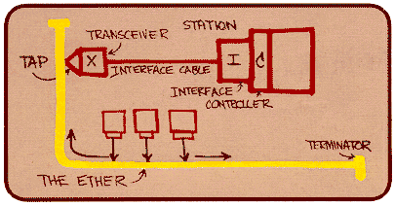
Ethernet
“dominant” wired LAN technology:
cheap $20 for NIC
first widely used LAN technology
simpler, cheaper than token LANs and ATM
kept up with speed race: 10 Mbps – 10 Gbps
Metcalfe’s Ethernet sketch

Slide 43

Ethernet: physical topology
bus: popular through mid 90s
  all nodes in same collision domain (can collide with each other)
star: prevails today
  active switch in center
  each “spoke” runs a (separate) Ethernet protocol (nodes do not collide with each other)
switch
star
bus: coaxial cable

Slide 44
Ethernet frame structure
sending adapter encapsulates IP datagram (or other network layer protocol packet) in Ethernet frame
preamble:
7 bytes with pattern 10101010 followed by one byte with pattern 10101011
used to synchronize receiver, sender clock rates
type
preamble
dest.
address
source
address
data (payload)
CRC

Slide 45
Ethernet frame structure (more)
addresses: 6 byte source, destination MAC addresses
  if adapter receives frame with matching destination address, or with broadcast address (e.g. ARP packet), it passes data in frame to network layer protocol
  otherwise, adapter discards frame
type: indicates higher layer protocol (mostly IP but others possible, e.g., Novell IPX, AppleTalk)
CRC: cyclic redundancy check at receiver
  error detected: frame is dropped
type
preamble
dest.
address
source
address
data (payload)
CRC

Slide 46
Ethernet: unreliable, connectionless
connectionless: no handshaking between sending and receiving NICs
unreliable: receiving NIC doesnt send acks or nacks to sending NIC
  data in dropped frames recovered only if initial sender uses higher layer rdt (e.g., TCP), otherwise dropped data lost
Ethernet’s MAC protocol: unslotted CSMA/CD with binary backoff

Slide 47
802.3 Ethernet standards: link & physical layers
many different Ethernet standards
  common MAC protocol and frame format
  different speeds: 2 Mbps, 10 Mbps, 100 Mbps, 1Gbps, 10G bps
  different physical layer media: fiber, cable
application
transport
network
link
physical
MAC protocol
and frame format
100BASE-TX
100BASE-T2
100BASE-FX
100BASE-T4
100BASE-SX
100BASE-BX
copper (twister
pair) physical layer
fiber physical layer

Slide 48
Link layer, LANs: outline
6.1 introduction, services
6.2 error detection, correction
6.3 multiple access protocols
6.4 LANs
  addressing, ARP
  Ethernet
  switches
7 Wireless Links and WLAN (Ch. 7)
6.7 a day in the life of a web request

Slide 49
Ethernet switch
link-layer device: takes an active role
  store, forward Ethernet frames
  examine incoming frame’s MAC address, selectively forward frame to one-or-more outgoing links when frame is to be forwarded on segment, uses CSMA/CD to access segment
transparent
  hosts are unaware of presence of switches
plug-and-play, self-learning
  switches do not need to be configured

Slide 50
Switch: multiple simultaneous transmissions
hosts have dedicated, direct connection to switch
switches buffer packets
Ethernet protocol used on each incoming link, but no collisions; full duplex
  each link is its own collision domain
switching: A-to-A’ and B-to-B’ can transmit simultaneously, without collisions
A
C’
B
6
1
2
5
4
3
B’
C
A’
switch with six interfaces
(1,2,3,4,5,6)

Slide 51
Switch forwarding table
Q: how does switch know A’ reachable via interface 4, B’ reachable via interface 5?
A
C’
B
A: each switch has a switch table, each entry:
  (MAC address of host, interface to reach host, time stamp)
  looks like a routing table!
6
1
2
5
4
3
B’
C
A’
Q: how are entries created, maintained in switch table?
  something like a routing protocol?
switch with six interfaces
(1,2,3,4,5,6)

Slide 52
Switch: self-learning
Source: A
Dest: A’
switch learns which hosts can be reached through which interfaces
  when frame received, switch “learns” location of sender: incoming LAN segment
  records sender/location pair in switch table
A
A A’
C’
B
6
1
2
5
4
3
B’
C
A’
MAC addr interface TTL
A
1
60
Switch table
(initially empty)

Slide 53
Self-learning, forwarding: example
Source: A
Dest: A’
A
A A’
frame destination, A’, locaton unknown:
flood
C’
B
destination A location known:
6
1
2
A A’
A A’
A A’
A A’
selectively send
on just one link
A A’
5
4
3
B’
C
A’ A
A’
MAC addr interface TTL
A
1
60
switch table
(initially empty)
A’
4
60

Slide 54

Interconnecting switches
switches can be connected together
S₄
S₁
S₃
A
S₂
F
I
B
C
D
E
G
H
Q: sending from A to G - how does S₁ know to forward frame destined to F via S₄ and S₃?
A: self learning! (works exactly the same as in single-switch case!)

Slide 55
Institutional network
mail server
to external
network
router
web server
IP subnet

Slide 56
Switches vs. routers
application
transport
network
link
physical
both are store-and-forward:
routers: network-layer devices (examine network-layer headers)
switches: link-layer devices (examine link-layer headers)
both have forwarding tables:
routers: compute tables using routing algorithms, IP addresses
switches: learn forwarding table using flooding, learning, MAC addresses
datagram
frame
link
physical
frame
switch
network
link
physical
datagram
frame
application
transport
network
link
physical

Slide 57
Link layer, LANs: outline
6.1 introduction, services
6.2 error detection, correction
6.3 multiple access protocols
6.4 LANs
  addressing, ARP
  Ethernet
  switches
7 Wireless Links and WLAN (Ch. 7)
6.7 a day in the life of a web request

Slide 58
Ch. 7: Wireless Networks
Background:
# wireless (mobile) phone subscribers now exceeds # wired phone subscribers (5-to-1)!
# wireless Internet-connected devices equals # wireline Internet-connected devices
  laptops, Internet-enabled phones promise anytime untethered Internet access
two important (but different) challenges
  wireless: communication over wireless link
  mobility: handling the mobile user who changes point of attachment to network

Slide 59





















Elements of a wireless network
wireless hosts
laptop, smartphone
run applications
may be stationary (non-mobile) or mobile
  wireless does not always mean mobility
network
infrastructure

Slide 60

Elements of a wireless network
base station
typically connected to wired network
relay - responsible for sending packets between wired network and wireless host(s) in its “area”
  e.g., cell towers, 802.11 access points
network
infrastructure

Slide 61
Elements of a wireless network
wireless link
typically used to connect mobile(s) to base station
also used as backbone link
multiple access protocol coordinates link access
various data rates, transmission distance
network
infrastructure

Slide 62
Characteristics of selected wireless links
200
802.11n
54
802.11a,g
802.11a,g point-to-point
5-11
802.11b
4G: LTWE WIMAX
4
3G: UMTS/WCDMA-HSPDA, CDMA2000-1xEVDO
Data rate (Mbps)
1
802.15
.384
2.5G: UMTS/WCDMA, CDMA2000
.056
2G: IS-95, CDMA, GSM
Indoor
10-30m
Outdoor
50-200m
Mid-range
outdoor
200m – 4 Km
Long-range
outdoor
5Km – 20 Km

Slide 63
Wireless Link Characteristics
important differences from wired link ….
  decreased signal strength: radio signal attenuates as it propagates through matter (path loss)
  interference from other sources: standardized wireless network frequencies (e.g., 2.4 GHz) shared by other devices (e.g., phone); devices (motors) interfere as well
  multipath propagation: radio signal reflects off objects and ground, arriving at destination at slightly different times
…. make communication across (even a point to point) wireless link much more “difficult”

Slide 64
IEEE 802.11 Wireless LAN
802.11b
2.4 GHz unlicensed spectrum
up to 11 Mbps
direct sequence spread spectrum (DSSS) in physical layer
  all hosts use same chipping code
802.11a
  5 GHz range
  up to 54 Mbps
802.11g
  2.4 GHz range
  up to 54 Mbps
802.11n: multiple antennae
  2.4 and 5 GHz range
  up to 200 Mbps
all use CSMA/CA for multiple access
all have base-station and ad-hoc network versions

Slide 65




IEEE 802.11: multiple access
avoid collisions: 2⁺ nodes transmitting at same time
802.11: CSMA - sense before transmitting
  don’t collide with ongoing transmission by other node
802.11: no collision detection!
  difficult to receive (sense collisions) when transmitting due to weak received signals (fading)
  can’t sense all collisions in any case: hidden terminal, fading
  goal: avoid collisions: CSMA/C(ollision)A(voidance)
A
B
C
C
B
A’s signal
strength
C’s signal
strength
A
space

Slide 66
IEEE 802.11 MAC Protocol: CSMA/CA
802.11 sender
1 if sense channel idle for DIFS then
  transmit entire frame (no CD)
2 if sense channel busy then
  start random backoff time
  timer counts down while channel idle
  transmit when timer expires
  if no ACK, increase random backoff interval, repeat 2
802.11 receiver
- if frame received OK
return ACK after SIFS (ACK needed due to hidden terminal problem)
sender
receiver
DIFS
data
SIFS
ACK

Slide 67
Avoiding collisions (more)
idea: allow sender to “reserve” channel rather than random access of data frames: avoid collisions of long data frames
sender first transmits small request-to-send (RTS) packets to BS using CSMA
  RTSs may still collide with each other (but they’re short)
BS broadcasts clear-to-send CTS in response to RTS
CTS heard by all nodes
  sender transmits data frame
  other stations defer transmissions
avoid data frame collisions completely
using small reservation packets!

Slide 68

Collision Avoidance: RTS-CTS exchange
A
B
AP
RTS(B)
RTS(A)
reservation collision
RTS(A)
CTS(A)
CTS(A)
DATA (A)
defer
time
ACK(A)
ACK(A)

Slide 69
Link layer, LANs: outline
6.1 introduction, services
6.2 error detection, correction
6.3 multiple access protocols
6.4 LANs
  addressing, ARP
  Ethernet
  switches
7 Wireless Links and
WLAN (Ch. 7)
6.7 a day in the life of a web request

Slide 70
Synthesis: a day in the life of a web request
journey down protocol stack complete!
  application, transport, network, link
putting-it-all-together: synthesis!
  goal: identify, review, understand protocols (at all layers) involved in seemingly simple scenario: requesting www page
  scenario: student attaches laptop to campus network, requests/receives www.google.com

Slide 71


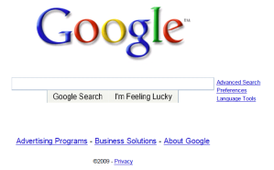
A day in the life: scenario
browser
DNS server
Comcast network
68.80.0.0/13
school network
68.80.2.0/24
web page
web server
Google’s network
64.233.160.0/19
64.233.169.105

Slide 72
A day in the life… connecting to the Internet
DHCP
DHCP
UDP
IP
Eth
Phy
connecting laptop needs to get its own IP address, addr of first-hop router, addr of DNS server: use DHCP
DHCP
DHCP
DHCP
DHCP
DHCP request encapsulated in UDP, encapsulated in IP, encapsulated in 802.3 Ethernet
DHCP
DHCP
UDP
IP
Eth
Phy
DHCP
DHCP
DHCP
DHCP
router
(runs DHCP)
Ethernet frame broadcast (dest: FFFFFFFFFFFF) on LAN, received at router running DHCP server
Ethernet demuxed to IP demuxed, UDP demuxed to DHCP

Slide 73
A day in the life… connecting to the Internet
DHCP
DHCP
UDP
IP
Eth
Phy
DHCP server formulates DHCP ACK containing client’s IP address, IP address of first-hop router for client, name & IP address of DNS server
DHCP
DHCP
DHCP
encapsulation at DHCP server, frame forwarded (switch learning) through LAN, demultiplexing at client
DHCP
DHCP
UDP
IP
Eth
Phy
DHCP
DHCP
DHCP
router
(runs DHCP)
DHCP
DHCP client receives DHCP ACK reply
Client now has IP address, knows name & addr of DNS
server, IP address of its first-hop router

Slide 74
A day in the life… ARP (before DNS, before HTTP)
DNS
UDP
IP
Eth
Phy
before sending HTTP request, need IP address of www.google.com: DNS
DNS
DNS
DNS
ARP
ARP query
DNS query created, encapsulated in UDP, encapsulated in IP, encapsulated in Eth. To send frame to router, need MAC address of router interface: ARP
ARP
ARP reply
Eth
Phy
router
(runs DHCP)
ARP query broadcast, received by router, which replies with ARP reply giving MAC address of router interface
client now knows MAC address of first hop router, so can now send frame containing DNS query

Slide 75
A day in the life… using DNS
DNS
UDP
IP
Eth
Phy
DNS
DNS server
DNS
UDP
IP
Eth
Phy
DNS
DNS
DNS
DNS
DNS
DNS
DNS
DNS
Comcast network
68.80.0.0/13
IP datagram forwarded from campus network into comcast network, routed (tables created by RIP, OSPF, IS-IS and/or BGP routing protocols) to DNS server
router
(runs DHCP)
IP datagram containing DNS query forwarded via LAN switch from client to 1st hop router
demux’ed to DNS server
DNS server replies to client with IP address of www.google.com

Slide 76
A day in the life…TCP connection carrying HTTP
HTTP
HTTP
TCP
IP
Eth
Phy
SYNACK
SYN
SYNACK
SYN
SYNACK
SYN
SYN
to send HTTP request, client first opens TCP socket to web server
router
(runs DHCP)
TCP SYN segment (step 1 in 3-way handshake) inter-domain routed to web server
TCP
IP
Eth
Phy
SYNACK
SYN
SYNACK
SYN
SYNACK
SYNACK
SYN
web server responds with TCP SYNACK (step 2 in 3-way handshake)
web server
64.233.169.105
TCP connection established!

Slide 77
A day in the life… HTTP request/reply
HTTP
HTTP
TCP
IP
Eth
Phy
web page finally (!!!) displayed
HTTP
HTTP
HTTP
HTTP
HTTP
HTTP
HTTP
HTTP
HTTP request sent into TCP socket
router
(runs DHCP)
IP datagram containing HTTP request routed to www.google.com
HTTP
HTTP
TCP
IP
Eth
Phy
HTTP
HTTP
HTTP
web server responds with HTTP reply (containing web page)
HTTP
web server
64.233.169.105
IP datagram containing HTTP reply routed back to client

Slide 78
Chapter 6/7: Summary
principles behind data link layer services:
  error detection, correction
  sharing a broadcast channel: multiple access
  link layer addressing
instantiation and implementation of various link layer technologies
  Ethernet
  switched LANS
  Wireless LANS
synthesis: a day in the life of a web request

